Slide 1
ABA Bus Maintenance and Repair Council Will Schaefer, Director of Safety Programs
June 2019

Slide 2
Who Are We?
The Commercial Vehicle Safety Alliance (CVSA) is a non-profit association comprised of local, state, provincial, territorial and federal commercial motor vehicle safety officials and industry representatives. The Alliance aims to achieve uniformity, compatibility and reciprocity of commercial motor vehicle inspections and enforcement activities by certified inspectors dedicated to driver and vehicle safety.
Notes:
We have 17 employees,
71 class 1 state/provincial/territory/Mexico (federal) members
38 Class 2 local agency members
513 Class 3 associate members
20 Federal agencies

Slide 3
Who Are We?
Notes:
We have 17 employees,
71 class 1 state/provincial/territory/Mexico (federal) members
38 Class 2 local agency members
513 Class 3 associate members
20 Federal agencies

Slide 4
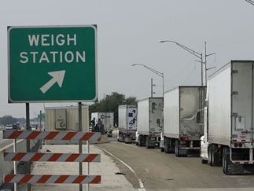
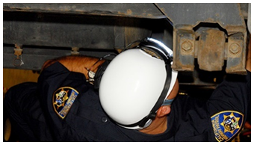
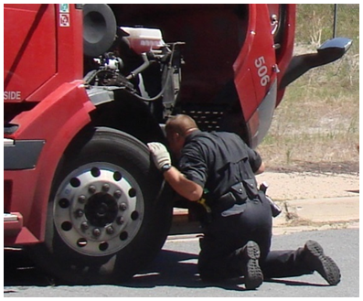
NAS Inspection Program
Overview
13,000+ CVSA-certified inspectors
2,200 CVSA-certified Passenger Carrier Inspectors
800,000+ Law enforcement personnel
Over 1,400 fixed facilities
Mobile patrols
Nearly 4 million roadside inspections annually
Notes:
Class I members include approximately 13,000 CVSA certified inspectors

Slide 5
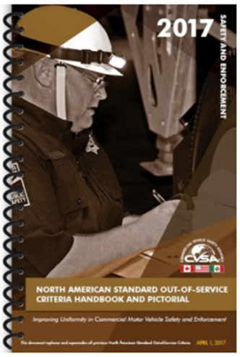
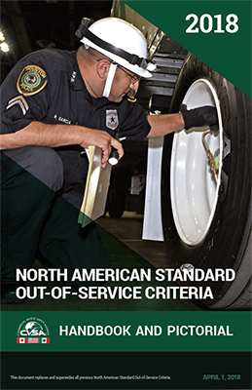
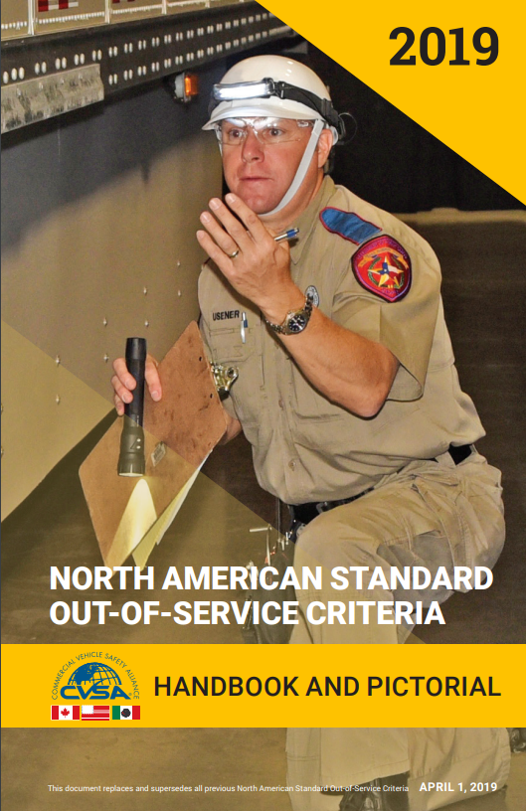
NAS Out-of-Service Criteria (OOSC)
What is it?
Violations of the regulation that represent an imminent hazard.
The driver and/or vehicle cannot continue until repairs are made and/or condition corrected.
What is it not?
The OOSC is an inspection guide and not a regulation.
The OOSC is not a performance or preventative maintenance standard.
Notes:
OOSC handbook is an inspection tool for enforcement.
May serve as a helpful reference for carriers to understand when inspectors place vehicles OOS but most violations are not represented in the handbook.
Over 80 percent of vehicle violations are non-OOS.

Slide 6
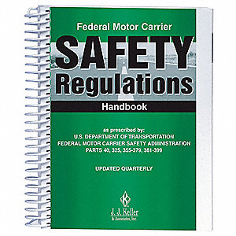
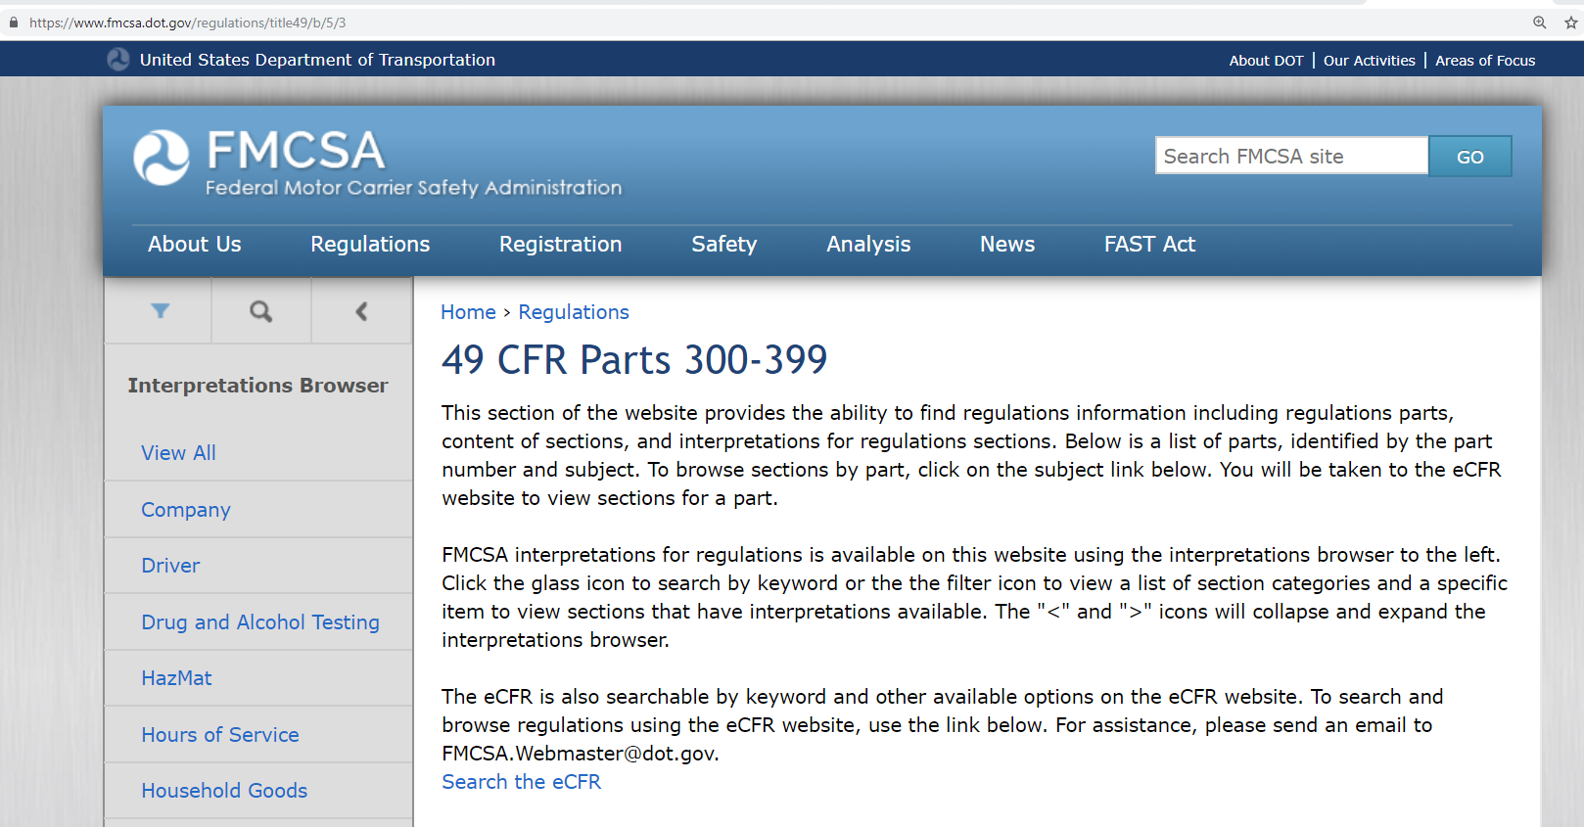
Not to be confused with the FMCSRs
https://www.fmcsa.dot.gov/regulations/title49/b/5/3
Credit: J.J. Keller

Slide 7
My topics for today
Operational Policy Changes
Inspection Procedure Changes
Inspection Bulletin Update
OOSC Changes
Inspection/Enforcement Programs and Blitzes Update
Automated CMV Working Group
Industry Courses/CVSA events
Notes:
Seven areas to cover today.

Slide 8
Operational Policy changes
Ops Policy 4 Inspector Training and Certification
April 2019: “…and North American Standard Cargo Tank Inspections.
Ops Policy 13 Selecting Vehicles for Inspection
Nov. 2018: “The following items should be considered when reviewing and adopting inspection selection policies in individual jurisdictions: … 11. Certified inspectors shall not disturb/interrupt any driver of a commercial motor vehicle in off-duty or sleeper berth status when legally parked for the purpose of conducting a random inspection.”
Ops Policy 14 Enhancing Roadside Inspections & Enforcement Data Uniformity
April 2017: “Documenting Violations: It is required to be as precise as possible when noting violations on inspection reports.
“When any violation is noted on an inspection report, indicate the location and description within the violation description field to provide sufficient information to persons not at the scene of inspection. (e.g., 2nd axle L/S inside tire has 2 inches of cord exposed in sidewall/air leak found at the 3rd axle R/S air hose fitting at brake chamber). It is also important to use language relevant to regulation and OOS Criteria (i.e. wheel fasteners vs lug nuts).”
Notes:
Ops Pol 4 – removes pre-requisite for bulk packaging inspectors to have cargo tank cert.
Ops Pol 13 – puts in policy the practice most states have of not disturbing a driver off duty in sleeper berth for an inspection
Ops Pol 14 – explicitly improves documentation of violations

Slide 9
My topics for today
Operational Policy Changes
Inspection Procedure Changes
Inspection Bulletin Update
OOSC Changes
Inspection/Enforcement Programs and Blitzes Update
Automated CMV Working Group
Industry Courses/CVSA events
Notes:
Seven areas to cover today.
Briefly who CVSA is.

Slide 10
Inspection Procedures
April 2019: NAS Level I, II and V Inspection Procedures –
STEP 13 Prepare Driver for Vehicle Inspection … “Inspect the driver seat to ensure it is present.”
STEP 21 Inspect rear of trailer … “REAR IMPACT GUARD - Check for damaged or missing rear impact guards and for compliance with regulatory requirements for the appropriate year of trailer manufacture, if applicable.”
STEP 28 Inspect steering axles … “INFORM THE DRIVER THAT YOU ARE GOING UNDER THE VEHICLE. ENTER THE UNDERCARRIAGE IN FULL VIEW OF THE DRIVER (AT FRONT OF POWER UNIT, REAR OF POWER UNIT AND IN FRONT OF TRAILER AXLE(S)).”
NOTE: It is recommended that the inspector have the driver remove the key from the ignition; however, the inspector must follow their jurisdiction’s policies and procedures.
Notes:
Driver seats present has been an uncommon but alarming issue.
I’ll come back to Rear Impact Guards in a later chapter.
Explicit safety related communications added, for timing.

Slide 11
My topics for today
Operational Policy Changes
Inspection Procedure Changes
Inspection Bulletin Update
OOSC Changes
Inspection/Enforcement Programs and Blitzes Update
Automated CMV Working Group
Industry Courses/CVSA events
Notes:
Seven areas to cover today.
Briefly who CVSA is.

Slide 12
Inspection Bulletins
Notes:
All of our bulletins have been re-touched in 2018 (new look and feel).
Bulletins have a long shelf life. Some longer than others. Once well engrained in training, we may “un-publish” or withdraw the bulletin.

Slide 13
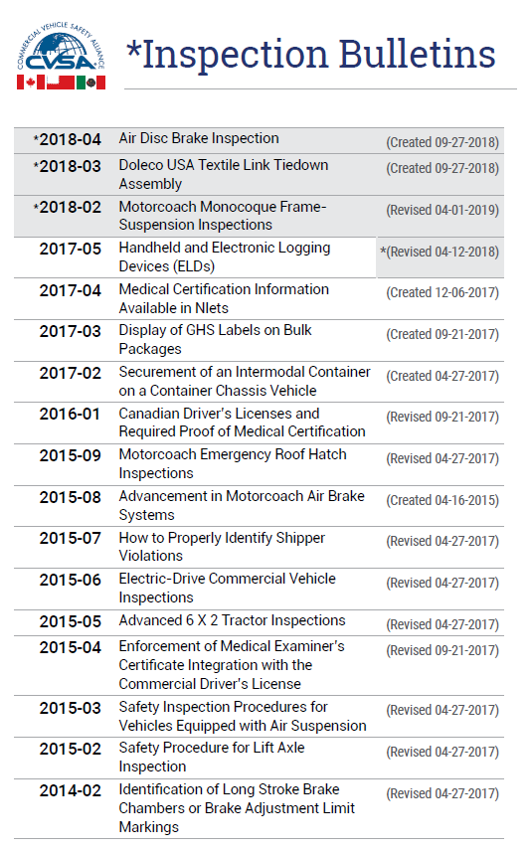
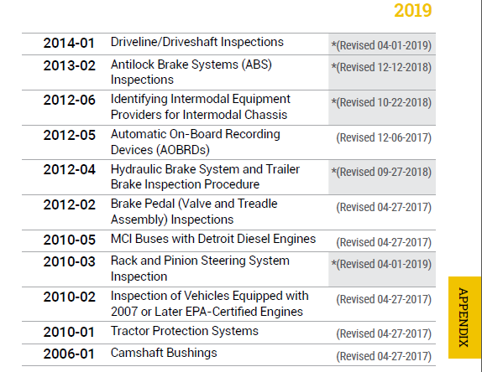
Inspection Bulletin Updates
Inspection Bulletins (new since April 2018)
2018-04 — Air Disc Brake Inspection (reviewed during the Kansas City Conference Review Webinar)
2018-03 — Doleco USA Textile Link Tiedown Assembly (reviewed during the Kansas City Conference Review Webinar)
2018-02 — Motorcoach Monocoque Frame-Suspension Inspections (reviewed during the Portland Workshop Review Webinar)
Other bulletins were revised and updated throughout the past year, they are highlighted in the list as well.
Notes:
The list of Inspection Bulletins in the Appendix of the OOSC was updated to reflect new bulletins. All inspection bulletins are available on the public side of the website or in the Operations Manual in the member portal.
Some bulletins have been revised to reflect the new Critical Inspection Item List. As of April 1, 2019, the following bulletins will be updated and posted to the website:
2014-01 Driveline Driveshaft Inspections
2010-03 Rack and Pinion Steering System Inspection
2018-02 Motorcoach Monocoque Frame-Suspension Inspections

Slide 14
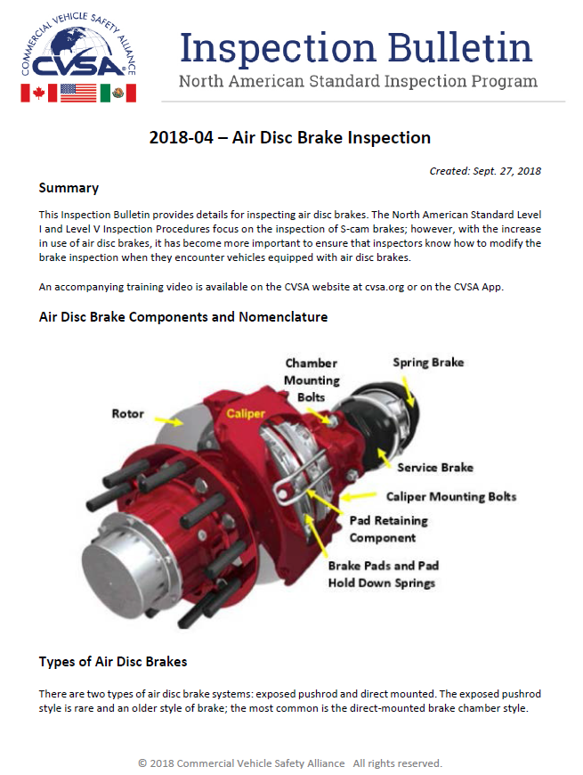
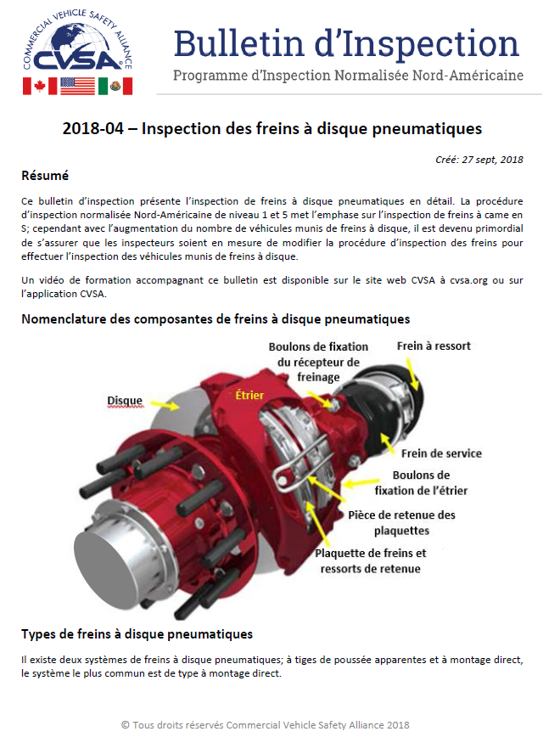
2018-04 Air Disc Brake Bulletin
English
French
Notes:
The reference to the new 2018-04 Inspection Bulletin on Air Disc Brake Inspection was put into the Criteria as a reference in the Air Disc Brake Section. This bulletin is currently available in English and French.
The Bulletin is available through the website and the Operations Manual in the member portal. The complete information on this bulletin was discussed during the webinar in the fall of 2018 and is available through the member portal for use during refresher training.

Slide 15
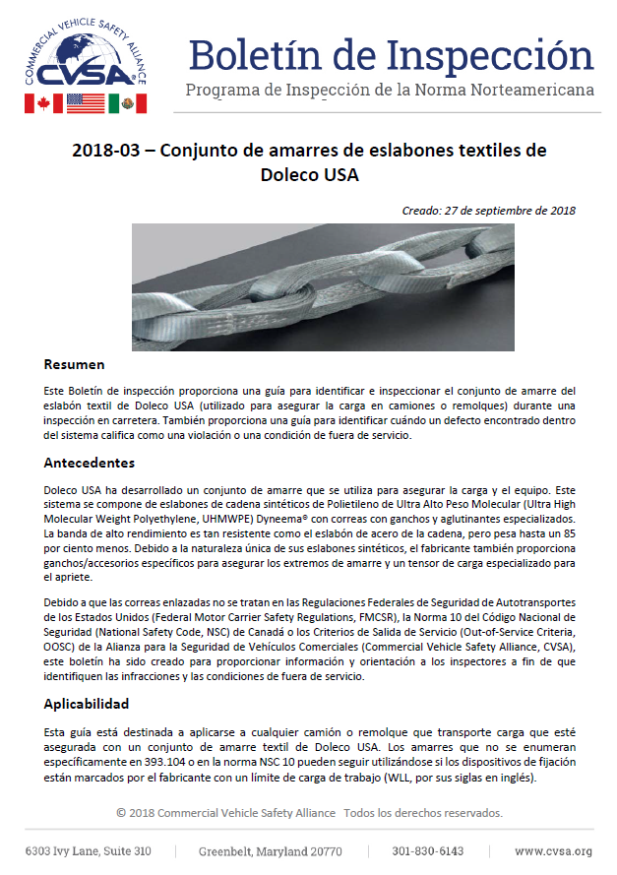
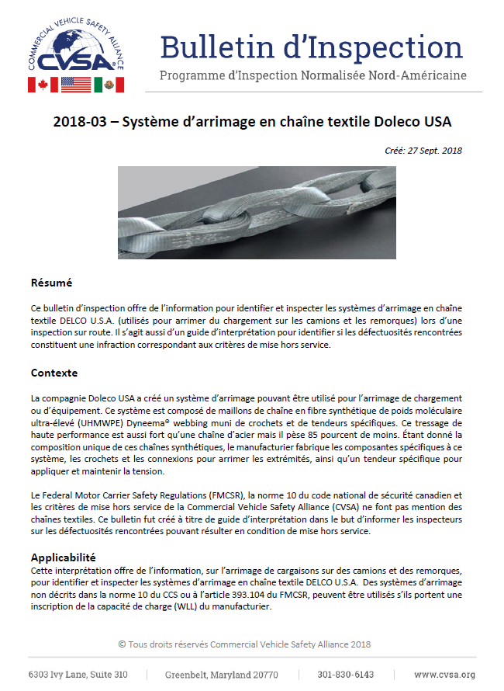
2018 -03 Doleco USA Textile Link Tiedown Assembly Inspection Bulletin
English
Spanish
French
Notes:
The reference to the new Inspection Bulletin on Doleco USA Textile Link Tiedowns was put into the Criteria. This bulletin is currently available in English, Spanish and French.
The Bulletin is available through the website an the Operations Manual in the member portal in 3 languages. The complete information on this tiedown and specific content of this bulletin was discussed and available through the last webinar after the fall conference.

Slide 16
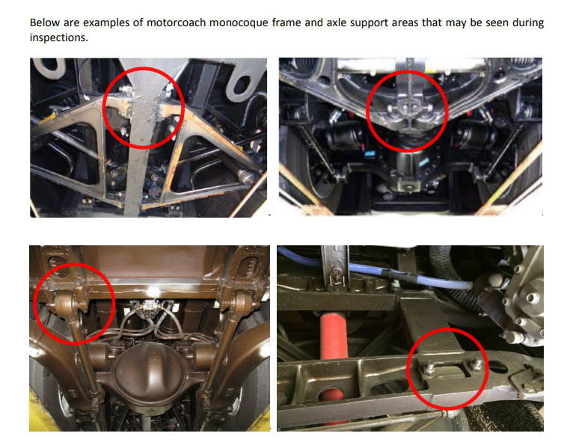
2018-02 Motorcoach Monocoque Frame-Suspension Inspections
English
French
Notes:
The reference to the new 2018-04 Inspection Bulletin on Air Disc Brake Inspection was put into the Criteria as a reference in the Air Disc Brake Section. This bulletin is currently available in English and French.
The Bulletin is available through the website and the Operations Manual in the member portal. The complete information on this bulletin was discussed during the webinar in the fall of 2018 and is available through the member portal for use during refresher training.

Slide 17
My topics for today
Operational Policy Changes
Inspection Procedure Changes
Inspection Bulletin Update
OOSC Changes
Inspection/Enforcement Programs and Blitzes Update
Automated CMV Working Group
Industry Courses/CVSA events
Notes:
Seven areas to cover today.

Slide 18
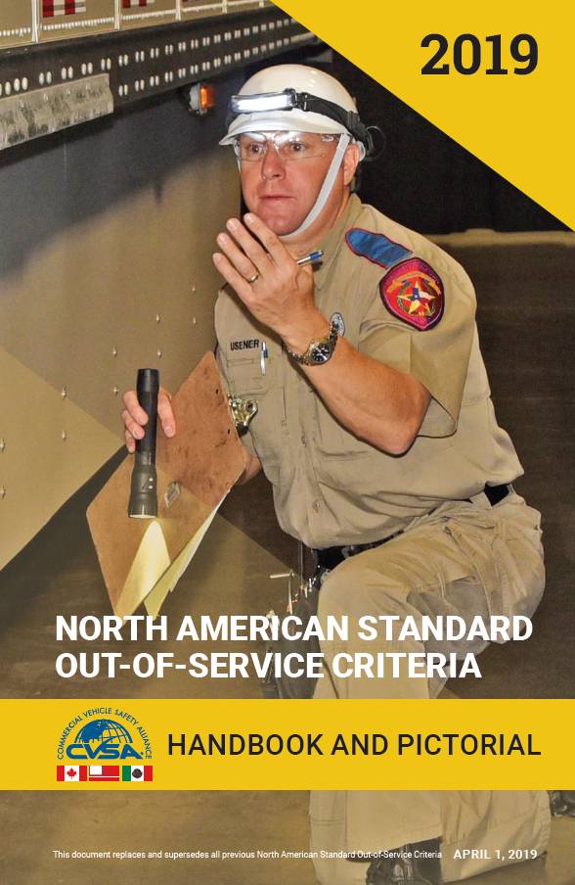
2019 Out-of-Service Criteria
Indicates there is an update for this item and the
specific subsections is also marked.
Grey highlight indicates the content change
Notes:
How the changes in the handbook are shown. The asterisk will be at the beginning of each section and subsection so it is evident what sections had changes and only the text that was edited is highlighted grey.

Slide 19
Part I – Driver Out-of-Service (U.S.)
*4. DRIVER MEDICAL/PHYSICAL REQUIREMENTS
*a. Skill Performance Evaluation Certificate
No skill performance evaluation in possession, when required or when operating a commercial motor vehicle without complying with the requirements indicated on the skill performance evaluation. (391.49(j)) Declare driver out of service.
Notes:
The North American Standard Out-of-Service Criteria (OOSC) stated that a driver shall be placed out of service for "No skill performance evaluation in possession, when required." However, a driver who possessed a valid Skill Performance Evaluation (SPE) but did not comply with the SPE requirements was not addressed in the OOSC. For example, a driver who possesses an SPE requiring a prosthetic limb but is not using it while driving was not currently an out-of-service condition. The Driver-Traffic Enforcement Committee agreed that this is as serious as if the SPE is not there. Therefore, the driver should be placed out of service.

Slide 20
Part II – Policy Statement
The decal criteria applies only to the condition of the vehicle, not the driver. It is possible for a driver to be out of service and still have vehicle(s) qualify for a decal. If each vehicle, whether used singly or in a combination, passes inspection, any expired CVSA decal shall be removed and a current CVSA decal shall be affixed.
Notes:
This amendment addressed a discrepancy between the language in Operational Policy 5 and the North American Standard Out-of-Service Criteria (OOSC) Part II Policy Statement regarding removing and/or replacing a CVSA decal.
Operational Policy 5 stated that any expired CVSA decal shall be removed before a new CVSA decal is affixed. However, the Policy Statement in Part II of the OOSC stated that “a current CVSA decal shall be affixed, and no other CVSA decals shall be visible.”
The language in the OOSC allowed for an existing decal to be covered up, rather than removed; the language in the Operational Policy does not. Covering up expired decals is problematic because colors can show on the corners and new decals can be removed by layering them on the vehicle. It was determined that removing old decals first is more appropriate.
Therefore, the Policy Statement in Part II of the OOSC was amended to reflect the same guidance as Operational Policy 5.

Slide 21
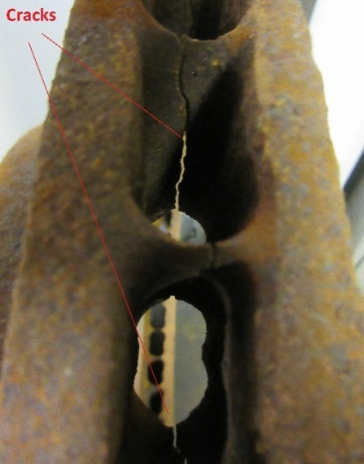
Part II – Vehicle Out-of-Service
*1. BRAKE SYSTEMS
*g. Brake Drums and Rotors (Discs)
*(2) Any rotor (disc) with a crack in length of more than 75 percent of the friction surface and passes completely through the rotor to the center vent from either side or completely through a solid rotor or completely through a structural support connecting the rotor friction surfaces.
** NOTE: Do not confuse short hairline heat check cracks with flexural cracks.
Notes:
Previously, language was amended in subsection (2) to include cracks in rotors to the vent area. The Vehicle Committee received information from a Society of Engineers workgroup indicating that with cracks through the vents, a collapse of the rotor is imminent. Therefore, the vehicle should be placed out of service. New language was added, as well as a picture of the condition to clearly outline the condition of the rotor.

Slide 22
Part II – Vehicle Out-of-Service
*2. CARGO SECUREMENT
*a. General Securement
*b. Articles Not Restrained from Rolling
*c. Articles Beside Each Other and Secured by Transverse Tiedowns
*d. Aggregate Working Load Limit
*e. Tiedowns for Length – No Front-End Structure
*f. Tiedowns for Length – Front-End Structure
Notes:
The Vehicle Committee added subheadings to the Cargo Securement section of the North American Standard Out-of-Service Criteria (OOSC), similar to the other sections in the OOSC. The new headings help with the uniformity of content in the rest of the criteria as well as make it easier to distinguish between the different sections of the OOSC.

Slide 23
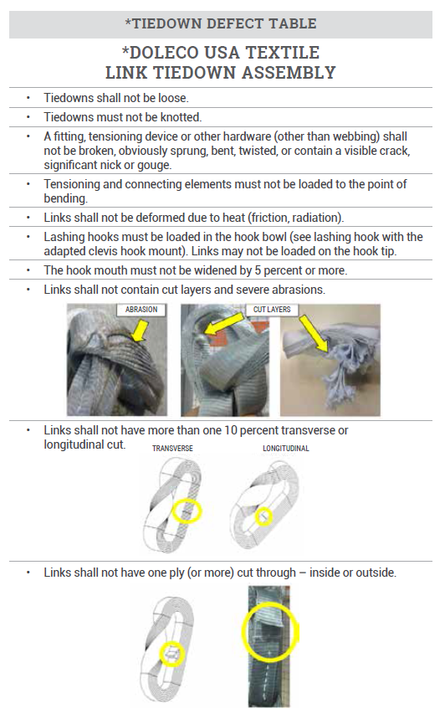
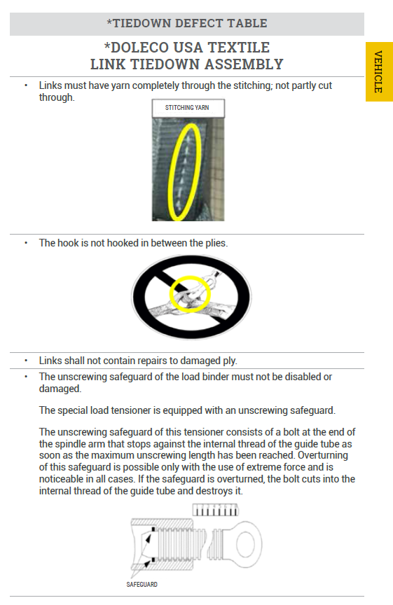
Part II – Vehicle Out-of-Service
*Tiedown
Defect Table
Notes:
The Vehicle and Training Committees approved the 2018-03 Inspection Bulletin outlining the characteristics and use for Doleco USA textile link tiedown assemblies. The North American Standard Out-of-Service Criteria required additional language be added to the Tiedown Defect Table, so that an inspector can adequately determine if the tiedown is defective once it is in use. As mentioned in the previous slide, the 2018-03 – Doleco USA Textile Link Tiedown Assembly Inspection Bulletin outlines details of the tiedown in order to adequately inspect for these conditions that would result in a defective tiedown.

Slide 24
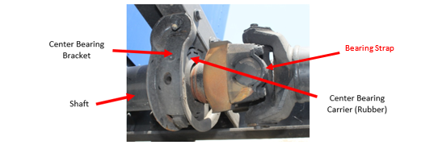
Part II – Vehicle Out-of-Service
*4. DRIVELINE/DRIVESHAFT
*b. Universal Joint
*(3) Any missing, broken or loose universal joint bearing cap bolt, bearing strap or retainer bolt.
Notes:
This issue was a result of a vehicle that was inspected and there was a broken bearing strap on a universal joint of a driveline/driveshaft. It was discussed that a broken bearing strap would have the same imminent hazard as a missing, broken or loose retainer bolt. The Vehicle Committee voted unanimously to add bearing strap into 4.b.(3) and to add a descriptive label to the current picture of a bearing strap in the North American Standard Out-of-Service Criteria to help identify and clarify what a bearing strap is.

Slide 25
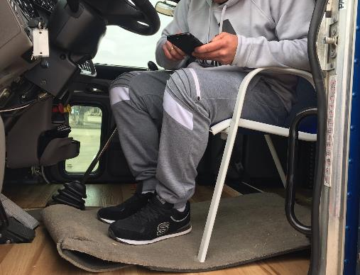
Part II – Vehicle Out-of-Service
*5. DRIVER’S SEAT (MISSING)
*a. Temporary Seating
*Any vehicle that has temporary seating for the driver.
NOTE: Temporary seating includes the use of items not designed for use as seats in vehicles, including but not limited to a milk crate, lawn chair, patio chair, folding chair, plastic step, stool or a cooler.
Notes:
A new critical inspection item was added to the North American Standard Out-of-Service Criteria (OOSC) regarding temporary driver seats. A request was received to add “drivers using a temporary seat” rather than a “permanent seat that is secured to the vehicle in a workmanlike manner” to the OOSC. This would be similar to the temporary seating condition found under the passenger-carrying vehicle section for passenger seats. A picture was provided of a vehicle that was stopped for inspection showing a driver sitting in a lawn chair inside a commercial motor vehicle. Through discussion, it was determined that this has been observed in previous cases and there was also a situation where a collision occurred due to a driver falling from the temporary seat because it was not mounted securely to the floor of the vehicle.
NOTE: This addition resulted in the renumbering of all the Critical Vehicle Inspection Items in the OOSC from Exhaust System forward as well as updates to Operational Policy 5 and Inspection Procedures.

Slide 26
Part II – Vehicle Out-of-Service
*6. EXHAUST SYSTEMS
*a. Leaks – All Commercial Motor Vehicles
*b. Gasoline-Powered Buses
*c. Buses Powered by Other Than Gasoline
*d. Location of Exhaust
Notes:
The Passenger Carrier Committee added subheadings to the Exhaust Systems section in Part II of the North American Standard Out-of-Service Criteria (OOSC), similar to the other sections in the OOSC. The new headings help with the uniformity of content in the rest of the criteria as well as make it easier to distinguish between the different sections of the OOSC.
The number of Exhaust also changed, due to the addition of the Driver’s Seat (Missing).

Slide 27
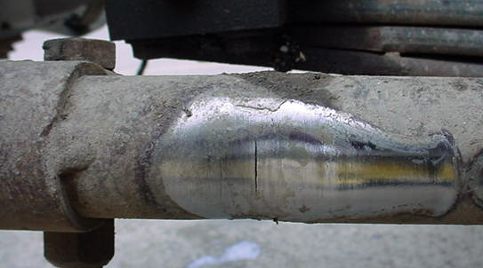
Part II – Vehicle Out-of-Service
*10. STEERING SYSTEMS
*h. Tie Rods and Drag Links
*(3) When a drag link is so worn to cause a non- manufactured hole.
Notes:
The North American Standard Out-of-Service Criteria was amended by adding language to address non-manufactured holes in the drag link of the steering system. Members of the industry were contacted, and it was discussed in committee, the severity of the drag link, and the loss of control if it fails. Having a worn hole could allow the link to buckle and lead to the loss of steering control. The recommendation by the industry partners was that a non-manufactured hole in a drag link should be placed out of service.
The Item number for Steering Systems was also updated to 10, due to the addition of Driver’s Seat (Missing).

Slide 28
Part II – Vehicle Out-of-Service
*16. BUSES, MOTORCOACHES, PASSENGER VANS OR OTHER PASSENGER-CARRYING VEHICLES – EMERGENCY EXITS/ELECTRICAL CABLES AND SYSTEMS IN ENGINE AND BATTERY COMPARTMENTS/SEATING (Temporary and Aisle Seats)
Notes:
The Passenger Carrier Committee made a previous amendment to the Critical Vehicle Inspection Item for Temporary Seating; inadvertently this amendment resulted in every seat in a passenger-carrying vehicle becoming a Critical Vehicle Inspection Item (temporary or otherwise). This was not the intent of the committee when the condition of temporary seating was introduced into the North American Standard Out-of-Service Criteria. This amendment was made to specify that temporary and aisle seats are the critical inspection item, and that vehicles with manufactured seating violations will still qualify for a CVSA decal, as they did in the past. The heading was also amended in the Critical Vehicle Inspection Item list.
The Item number for BUSES, MOTORCOACHES, PASSENGER VANS OR OTHER PASSENGER-CARRYING VEHICLES – EMERGENCY EXITS/ELECTRICAL CABLES AND SYSTEMS IN ENGINE AND BATTERY COMPARTMENTS/SEATING (Temporary and Aisle Seats) was also updated to 16, due to the addition of Driver’s Seat (Missing).

Slide 29
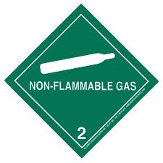
Part III – HM/DG Out-of-Service
Part III was completely redone to format the wording to be consistent with the rest of the criteria.
Subtitles were added where required.
Redundant language was removed. (e.g., “An out-of-service condition exists when……)
Notes:
Part III of the OOSC was completely revised for consistency.

Slide 30
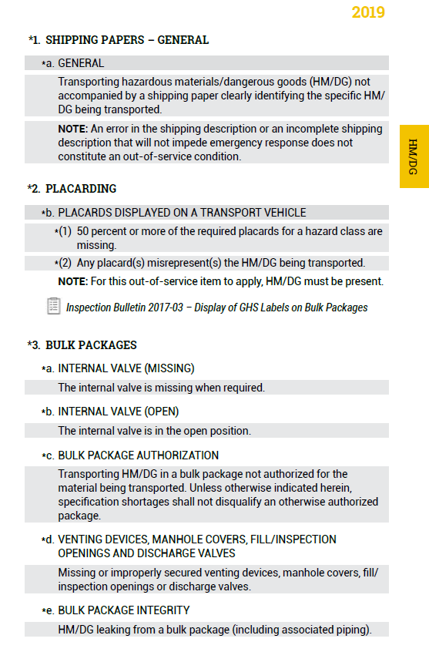
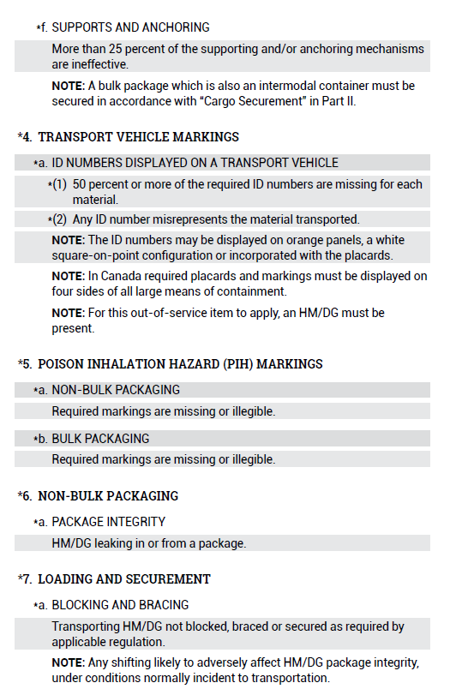
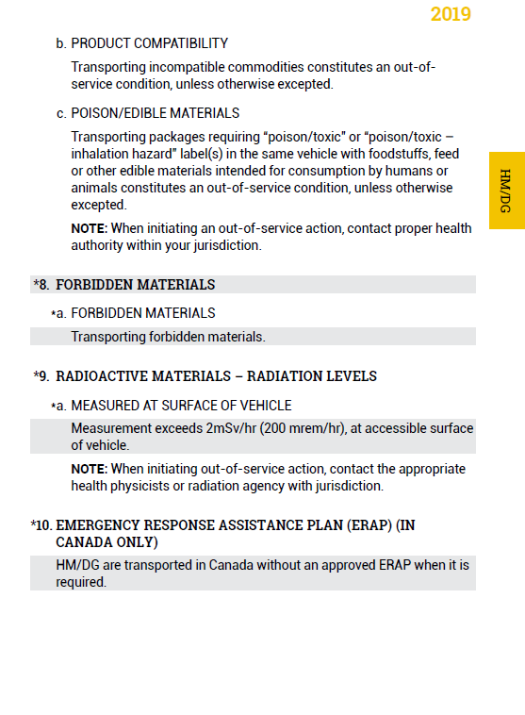
Part III – HM/DG Out-of-Service
Notes:
The Hazardous Materials Committee made a series of amendments to the Placarding and Marking section of Part III of the North American Standard Out-of-Service Criteria (OOSC), because the wording was a source of confusion.
It became apparent through discussion that Part III of the OOSC needed to follow the same format as the rest of the OOSC. The committee agreed that by making the edits in formatting and removing redundant language, Part III would be consistent with the rest of the OOSC.

Slide 31
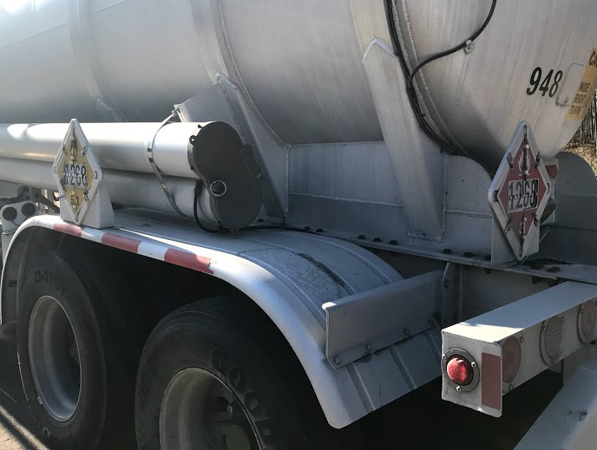
Part III – HM/DG Out-of-Service
*2. PLACARDING
*a. Placards Displayed on a Transport Vehicle
(1) When 50 percent or more of the required placards for a hazard class are missing.
(2) When any placard(s) misrepresent(s) the HM/DG being transported.
NOTE: For this out-of-service item to apply, HM/DG must be present.
Inspection Bulletin 2017-03 – Display of GHS Labels on Bulk Packages
Notes:
The section for Placarding (the way it was written) would lead some to not put a vehicle OOS for a misleading placard or marking. It was determined that separating the section would help clarify this OOS condition vs missing which refers to the 50 percent.

Slide 32
Part III – HM/DG Out-of-Service
*4. TRANSPORT VEHICLE MARKINGS
*a. ID Numbers Displayed on a Transport Vehicle
(1) When 50 percent or more of the required ID numbers are missing for each material.
(2) When any number misrepresents the material being transported.
NOTE: The ID numbers may be displayed on orange panels, a white square-on-point configuration or incorporated with the placards.
NOTE: In Canada, required placards and markings must be displayed on four sides of all large means of containment.
NOTE: For this out-of-service item to apply, an HM/DG must be present.
Notes:
Similar to the placarding section, the section for Transport Vehicle Markings (the way it was written) would lead some to not put a vehicle OOS for a misleading placard or marking. It was determined that separating the section would help clarify this OOS condition.

Slide 33
2019 Out-of-Service Criteria
Bulk Order Discounts
Class I Member Agency/Department
Class II Local Member Agency/Department
50 or more – $25.00 each (USD)
Class III Associate Member Trucking Association
50 or more – $30.00 each (USD)
Bulk orders by email – irisl@cvsa.org
Notes:
Discount prices of the handbook for members of enforcement member agencies, local member agencies and trucking association members.

Slide 34
2019 CVSA App
Out-of-Service Criteria
Inspection Procedures
Canadian Driver’s License Charts
Pictorial
Inspection Bulletins
Operational Policies
Video Library
Learning Management System
Brochures
Available through the App Store – $49.99 (USD)
App Store – CVSA April 1, 2019 OOSC
Google Play Store – CVSA April 1, 2019 OOSC
Notes:
Information on the App, the cost and how to find it.

Slide 35
My topics for today
Operational Policy Changes
Inspection Procedure Changes
Inspection Bulletin Update
OOSC Changes
Inspection/Enforcement Programs and Blitzes Update
Automated CMV Working Group
Industry Courses/CVSA events
Notes:
Seven areas to cover today.

Slide 36
2018 Roadcheck Results (June 5-7)
67,603 Level I, II and III inspections
Level I - 45,501
Level II - 11,458
Level III - 10,644
Level I vehicle out-of-service rate was 21.6 percent
Level I, II and III driver out-of-service rate was 3.9 percent
Brake adjustment and brake system violations combined to represent 44.7 percent (7,157) of all out-of-service vehicle violations.
Notes:
For perspective on what that is, here is from 2018.

Slide 37
2018 Roadcheck Results (June 5-7)
OOS Violations Category | Percentage of Vehicle OOS Conditions | Driver OOS Violation Category | Percentage of Driver OOS Conditions | HM/DG OOS Violation Category | Percentage of HM/DG OOS Conditions
Brake Systems | 28.4% | Hours of Service | 43.7% | Loading/Securement | 25.6%
Tires/Wheels | 19.1% | Wrong Class License | 21.4% | Other HM/DG | 21.3%
Brake Adjustment | 16.3% | False Record of Duty Status | 10.2% | Shipping Papers | 19.9%
Cargo Securement | 13% | Other | 9.4% | Placards | 18%
Lighting | 12% | Suspended License | 8.2% | Markings | 12.8%
Suspension | 4.2% | Violating License Restriction | 4% | Package Integrity | 2.4%
Steering | 2.2% | Drugs/Alcohol | 2.7%
Other | 1.5% | Expired License | 0.5%
Driveline/Driveshaft | 1%
Frame | 1%
Coupling Devices | 0.7%
Exhaust | 0.3%
Fuel | 0.2%
NOTE: These percentages are U.S. and Canada results combined. A subsequent
slide includes some refinements of violations only available for U.S. inspections.
Notes:
We’re in the house that lighting built, so I noted lighting here, with 12% of OOS violations.
However, if you look at violations issued, 393.9 Inoperable Required Lamp represents by far the single most issued violations—2.5 times more frequently cited than the next common violations (brake adjustment).
Lamp violations represent 21%, over on out of every 5 violations, issued in 2018.
It should be noted that any one vehicle has many brakes and many more lamps. Violations are not counted twice in an inspection, but nonetheless the likelihood of a violation from lamps is at the top.

Slide 38
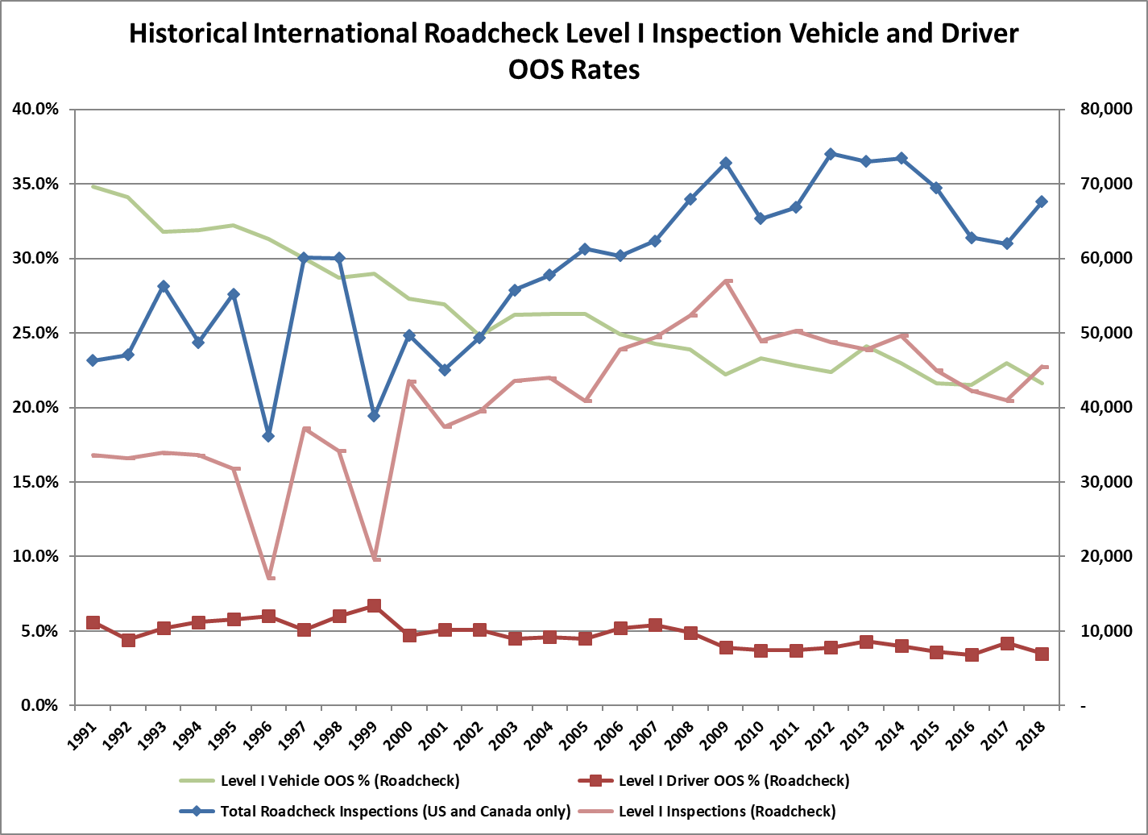
2018 Roadcheck Results (June 5-7)
Notes:
Not that these are raw results with no normalizing for many factors that affect vehicle and driver OOS rates and numbers of inspections.

Slide 39
2018 Brake Safety Week (Sept. 16-22)
Inspection Anecdote:
“On September 17 at the Wildwood scales on I-75 in Marion County, Florida, Tpr. Robert Smith went to measure a brake chamber on a steer axle. When the driver pressed on the brake pedal the chamber exploded. Tpr. Smith said it sounded like a cannon going off.”

Slide 40
2018 Operation Airbrake (Sept. 2018)
Brake Safety Week held Sept. 2018 35,080 Inspections
26,143 air-braked power units required ABS; 8.3 percent (2,176) had ABS violations.
17,857 trailers required ABS; 12.5 percent (2,224) had ABS violations.
5,354 hydraulic-braked trucks required ABS; 4.4 percent (234) had ABS violations.
651 motorcoaches/buses required ABS; 2 percent (13) had ABS violations.

Slide 41
2019 Brake Safety Day (some day in May)
Brake Safety Day pre-view - May 15 - At least 7,500 inspections
Preliminary results:
U.S. 17.1% OOS for brakes
Canada 13.4% OOS for brakes
Focused on brake hoses and tubing:
Number of units with chafed rubber hose violations? 721
Number of units with chafed thermoplastic hose violations? 119

Slide 42
2018 Operation Safe Driver Week
Traffic enforcement (both CMVs and light vehicles/passenger cars).
July 15-21 ,2018. Total 113,331 contacts with CMV drivers and light vehicle drivers. 57,405 citations; 87,9087 warnings.
The top five citations issued to CMV drivers were:
State/Local Laws – 6,008 citations
Speeding – 1,908 citations
Failing to use a seat belt while operating a CMV – 1,169 citations
Failure to obey a traffic control device – 754 citations
Using a handheld phone – 262 citations

Slide 43
2018 Operation Safe Driver Week
Traffic enforcement (both CMVs and light vehicles/passenger cars).
July 15-21 ,2018. Total 113,331 contacts with CMV drivers and light vehicle drivers. 57,405 citations; 87,9087 warnings.
The top five citations issued to passenger vehicle drivers were:
State/Local Laws – 21,511 citations
Speeding – 16,909 citations
Failing to use a seat belt – 3,103 citations
Inattentive and/or careless driving – 1,655 citations
Failure to obey a traffic control device – 739 citations

Slide 44
My topics for today
Operational Policy Changes
Inspection Procedure Changes
Inspection Bulletin Update
OOSC Changes
Inspection/Enforcement Programs and Blitzes Update
Automated CMV Working Group
Industry Courses/CVSA events
Notes:
Seven areas to cover today.

Slide 45
CVSA/FMCSA Automated CMV Working Group
CVSA and FMCSA formed this working group to develop a concept of how automated CMVs could be inspected at roadside.
Phase I focus is what enforcement can do with a vehicle stopped in front of us (as opposed to the procedures of pulling an automated vehicle over)
Phase I result to be presented in September, followed by written summary thereafter.

Slide 46
My topics for today
Operational Policy Changes
Inspection Procedure Changes
Inspection Bulletin Update
OOSC Changes
Inspection/Enforcement Programs and Blitzes Update
Automated CMV Working Group
Industry Courses/CVSA events
Notes:
Seven areas to cover today.

Slide 47
CVSA Courses and Events
Notes:
Seven areas to cover today.

Slide 48
CVSA Courses and Events
Notes:
Seven areas to cover today.

Slide 49
CVSA Courses and Events
Notes:
Seven areas to cover today.

Slide 50
Will Schaefer, Director of Safety Programs
williams@cvsa.org
301-830-6154

