Slide 1


ABA Board of Directors Update
February 3, 2023
Detroit, MI
B I S C
20 Years

Slide 2


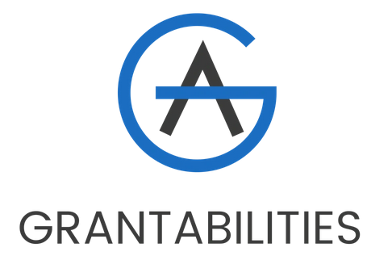








Special Thanks to our Sponsors
PRESENTED BY THE BUS INDUSTRY SAFETY COUNCIL
SPONSORED BY ABC COMPANIES

Slide 3

BISC Goals
- Better Serve Our Members
- Make it Easier to Communicate
Provide Takeaways
Answer Questions
  BISC-IT
- Expand Membership & Attendance
- Attract More Sponsors
PRESENTED BY THE BUS INDUSTRY SAFETY COUNCIL
SPONSORED BY ABC COMPANIES

Slide 4
Recent Activities
Fall Webinar Series (6 webinars)
BISC West with California Bus Association
Virginia Motorcoach Association Operations & Maintenance Retreat
Leadership Elections (3 new team members)
Orientation Webinar
Winter Meeting in Detroit
PRESENTED BY THE BUS INDUSTRY SAFETY COUNCIL
SPONSORED BY ABC COMPANIES

Slide 5
2023 Winter Meeting Highlights
Partnership with IMG and BusWorld
Keynote Address from David Strickland on Electric Vehicles
21 Curated Sessions (Plus 4 Co-promoted BusWorld Sessions)
Heavy Mentor Involvement, Floor Booth
PRESENTED BY THE BUS INDUSTRY SAFETY COUNCIL
SPONSORED BY ABC COMPANIES

Slide 6
2023 Winter Meeting Highlights
Driver of the Year Awardee
Norm Littler Awardee
Moving Around Future Meetings, Increasing Exposure
PRESENTED BY THE BUS INDUSTRY SAFETY COUNCIL
SPONSORED BY ABC COMPANIES

Slide 7
Future Plans
Additional Partnerships with State Associations
Outreach to Limo Associations
Expand Subject Matter Expert and Mentor Touch Points
Enhancing 101 Series
More Resources for Operators
PRESENTED BY THE BUS INDUSTRY SAFETY COUNCIL
SPONSORED BY ABC COMPANIES

Slide 8
Take Advantage of Our Experts!
PRESENTED BY THE BUS INDUSTRY SAFETY COUNCIL
SPONSORED BY ABC COMPANIES

