Slide 1
BISC / BusMARC Summer Meeting 2022
Campaigns and Recall’s

Slide 2
Presentation Team:
David Mailhot
MCI
Regional Director – Private Sector
Technical Solutions Team
Benjamin Kopp
Regional Maintenance Director
Coach USA

Slide 3
What are Campaigns and Recall?
Campaign, Service campaigns are field actions, technical bulletins, and safety alerts. A service campaign enables a business to increase service revenue, improve product performance and increase customer satisfaction.
Recall, A product recall is defined as a request to return, exchange, or replace a product after a manufacturer or consumer watch group discovers defects that could hinder performance
It is the goal for every vehicle manufacturer to produce the best product possible. Safety, Reliability and Performance are very important for both the customer and the manufacturer. As a vehicle is placed in operation there can be unforeseen issues that may develop that will affect the operation of the vehicle and may require some action from the OEM or the customer.
The goal of these campaigns or recalls is to increase Safety, Reliability, Performance, Serviceability and Customer Satisfaction.

Slide 4
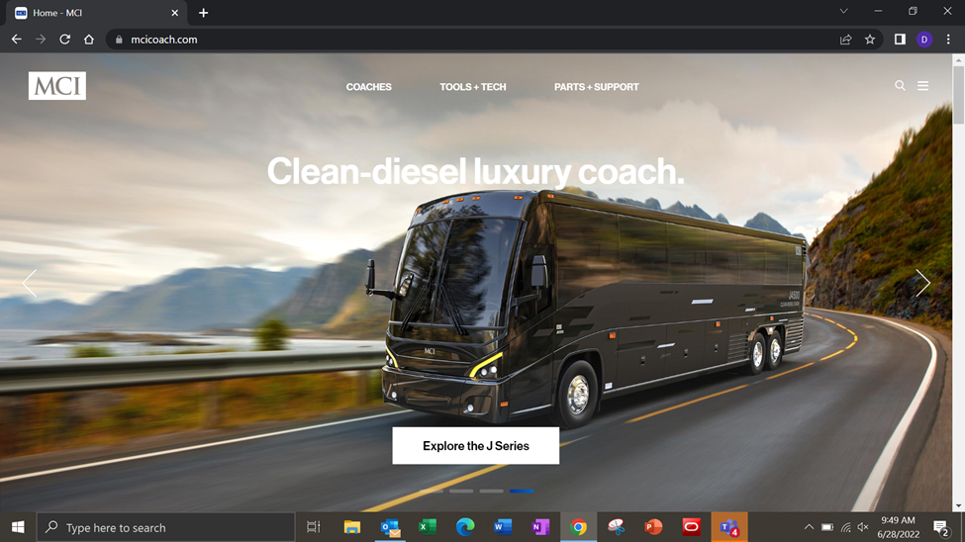
How to find them:

Slide 5
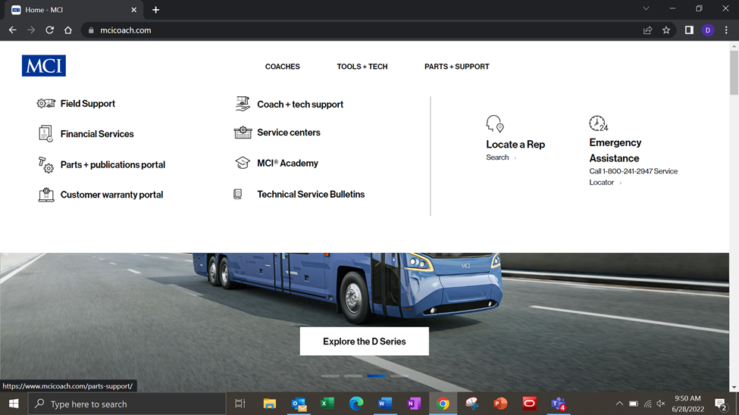

Slide 6
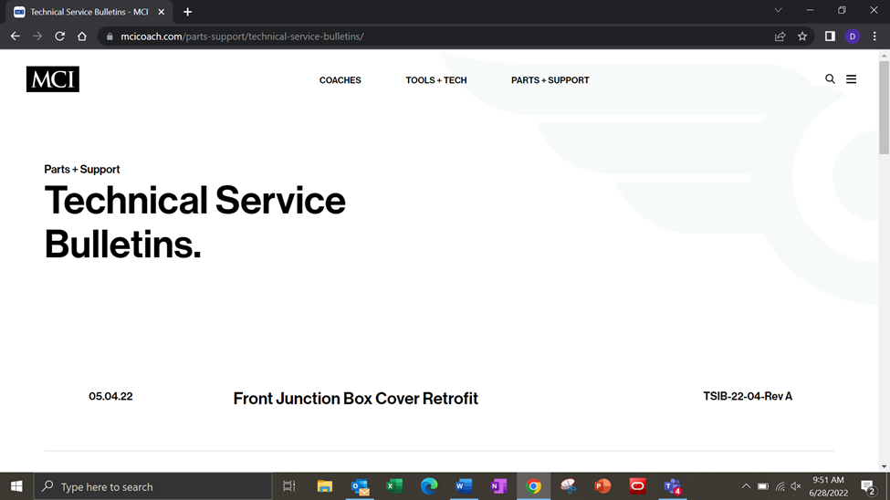

Slide 8
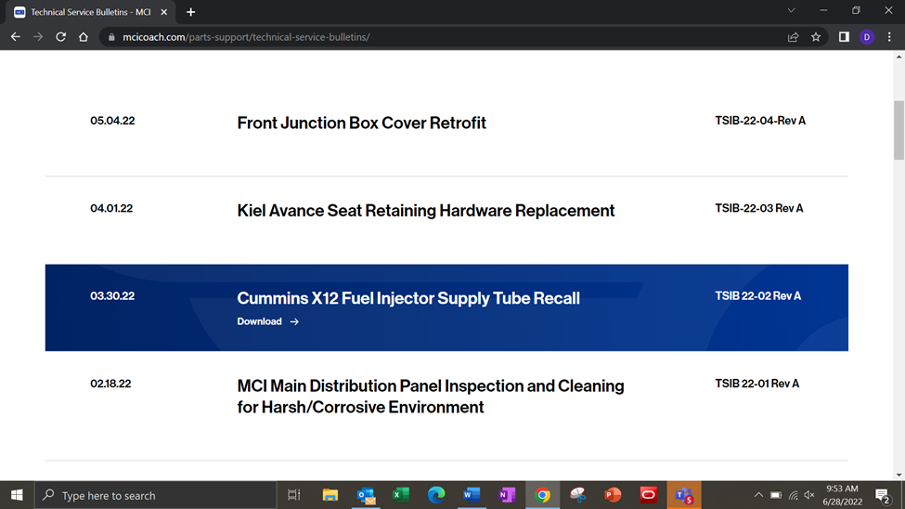

Slide 9
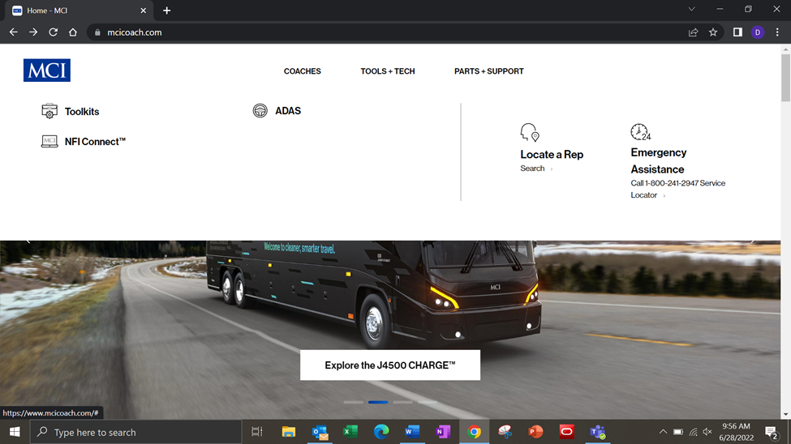
Other useful information on this site:

Slide 10
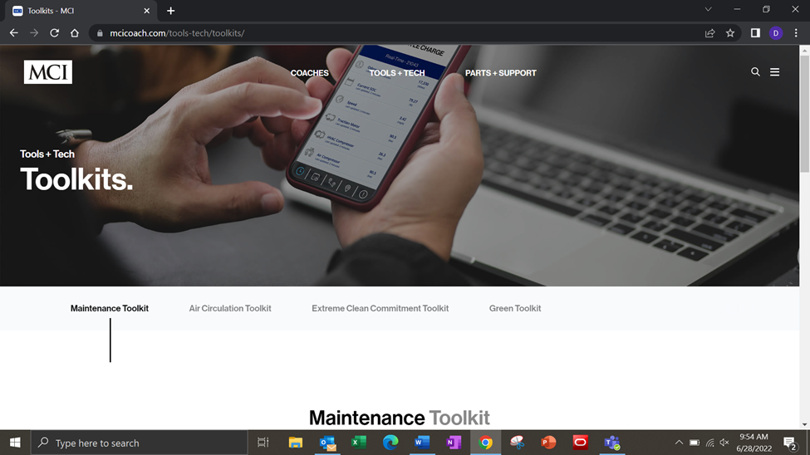

Slide 11
