Slide 1
Military Bus Program
Donna Johnson
Rob Johnson
March 2019

Slide 2
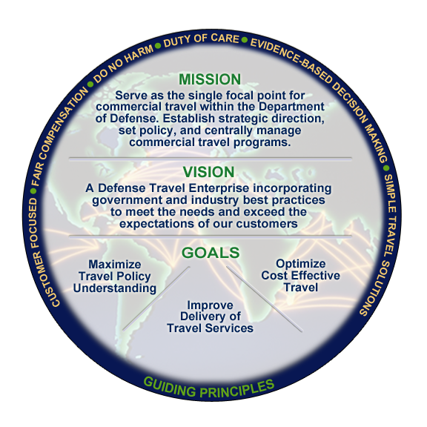
Defense Travel Management Office
Scope of the Enterprise
DoD Travel Spend: $9.2B (FY17)
Travel Management Company Services: $236M/5 years
U.S. Car/Truck Rental Program: $606M (FY18)
Government Travel Charge Card: ~$75B/13 Years
DoD Preferred Commercial Lodging: $106M (FY18)
Commercial Travel Program Management
GSA City Pair – DoD Customer Interface
U.S. Government Rental Car/Truck
Military Bus Program
Recruit Travel & Assistance
Travel Management Company Services
Premium Class Travel Oversight
Integrated Lodging Program Pilot
Preferred Dining Program Pilot
Travel Policy and Implementation
Joint Travel Regulations (JTR)
Policy Simplification
Travel Policy Compliance Program
OCONUS Non-Foreign Per Diem
Customer Support and Training
Travel Assistance Center (TAC)
Travel Training Resources
Service and Agency Liaison
DoD Travel Card Program Management
Individually Billed Accounts
Centrally Billed Accounts
The Past: Establishment and consolidation
The Present: Sustainment, improvement, run operations, and conduct Travel Transformation efforts
The Future: Reformed Travel Enterprise
Defense Travel System
Functional Requirements and Oversight
Travel System Modernization
Area of Focus
Travel Reform – Simplify travel policy and explore the best strategy for providing travel services in the future
Notes:
Defense Travel Management Office Background
MID 921 established DTMO in 2006 to consolidate, streamline, and centrally manage commercial travel for the DoD
DTMO has direct oversight for the programs, policies, processes, and the system that results in $8.1B (FY15) in annual travel spend across the Department
DTMO has direct oversight of station/housing allowance programs that benefit members when they travel/move that result in $24.3B (FY16) spend across DoD
Partnerships – DTMO partners across the government and private sector to maintain an in-depth perspective of the travel industry and determine the best practices and standards for DoD travel. This provides us with a way to think about how to manage and reform travel for the DoD customer
Commercial Travel Management - Provides program management for Travel Management Company (TMC) services; U.S. Government Rental Car/Truck Programs; Department of Defense (DoD) Integrated Lodging Program Pilot; DoD Preferred Dining Program Pilot; Recruit Travel & Assistance Programs; Military Bus and Passenger Surface Inspection Programs (PSIP); Premium Class Travel (PCT) Management; and the GSA Contract City Pair Program (Air).
Travel Card Program Management - Provides program management of the DoD Government Travel Charge Card (GTCC) Program (~$4B/year) for ~1.6M cardholders through the GSA SmartPay® 2 task order to include: coordination with GSA, DoD components and the GTCC card vendor; development of travel card policy and procedures; travel card training; Centrally Billed Account (CBA) reconciliation; Individually Billed Account (IBA) management; delinquency management; Rebate Program management; and Agency support.
Travel Policy and Implementation - DTMO develops and implements policy and regulations for the reimbursement of travel expenses to all Uniformed members (Army, Navy, Air Force, Marine Corps, Coast Guard, Public Health Service, and the National Oceanic and Atmospheric Administration) and for DoD civilian employees, and implements within DoD the civilian travel rules prescribed for Federal civilian travelers by the General Services Administration (GSA) in the Federal Travel Regulation (FTR). This includes a single volume, Joint Travel Regulations; DoD Instruction (DoDI) 5154.31 (new multi-volume issuance); travel policy simplification; Travel Reengineering Information Process System (TRIPS); and Travel Policy Compliance Program
Customer Support and Training - Provides a comprehensive set of resources to DoD travelers and travel managers to include: management of the Travel Assistance Center (TAC) providing 24/7/365 assistance to DoD travel community; training resources for DTS users and administrators to include Web-based Training courseware, reference materials, and instructor resources for use DoD-wide; and management of the Travel Certificate Program.
Allowance Program Management - DTMO performs analysis, prescribes rates, and provides program management for Basic Allowance for Housing (BAH), Overseas Cost of Living Allowance (COLA), CONUS COLA, Overseas Housing Allowance (OHA), OCONUS Non-foreign per diem rates, and currency adjustments.
Functional Oversight of the Defense Travel System (DTS) - Develops functional requirements for DTS and coordinates/obtains their approval through the Governance Board(s); manages the DTS change/configuration management process (DTS sustainment); program lead for the DTS Modernization Initiative.
Our focus is on Travel Reform--Simplify travel policy, explore the best strategy for providing travel services in the future, and implement allowance efficiencies

Slide 3
Program Overview
Ensures that commercial bus, van and limousine companies offering charter service provide safe vehicles that consistently meet DoD standards of service.
DTMO manages the program through an agreement with carriers that includes specific terms, conditions and standards that must be met when providing transportation for DoD passengers.
Military Bus Agreement #4 and the Van and Limousine Addendum

Slide 4
Military Bus Agreement
Establishes terms, conditions, and safety standards for commercial motor carriers
Incorporates regulations outlined in Federal Motor Carrier Safety Regulation (FMCSR)
Provides guidance on:
Carrier qualification
Application
Quality assurance requirements
Carrier compliance
Performance
Requirements
Inspections—scheduled and unscheduled

Slide 5
Overview of Program Changes
The Passenger Surface Inspection Program (PSIP) no longer exists
Military Bus Agreement Improvements
New Memorandums of Understandings (MOUs) with FMCSA and CVSA
Mandated use of Group Operational Passenger System (GOPAX)
Data requirements and Carrier Movement Reporting (CMR)

Slide 6
1. PSIP No Longer Exists
Contracted vehicle inspection company to inspect participating motor coach, van and limousine company’s equipment, terminals, and personnel due to Department of Transportation timing on bus inspections (every five years versus requirement of every 3 years)
Congress directed Federal Motor Carrier Safety Administration (FMCSA) to modify timing of inspections from every 5 years to every 3 years in December 2015 under the Fixing America’s Surface Transportation (FAST) Act
DoD now uses DOT inspection reports

Slide 7
2. Military Bus Agreement Improvements
Clarifies application and operations requirements
Removes DTMO imposed requirements for inspections
Eliminates intrastate carriers from program
All participating carriers will be interstate carriers
Allows carriers to utilize sleeper berths as long as they meet Department of Transportation (DoT) requirements
Enhances cancellation policy to clarify charges allowed (i.e. operating costs versus cancellation fees)
Considering how to strengthen emergency/national priority response consideration

Slide 8
Military Bus Agreement Improvements (continued)
Removes Equal Employment Opportunity, insurance provisions, and Drug and Alcohol verbiage as they are requirements in FMCSR
Clarifies that carriers meet TSA requirements for transporting hazardous material(s)
Details requirement for carrier to cover costs associated with movement delays (i.e. meals, lodging, air, waiting time, etc.)
Excludes taxi service from agreement
Adds Carrier’s Rights paragraph which allows carriers to refuse additional personnel, baggage or impedimenta that would cause equipment to violate Federal laws or manufacturers’ safety guidelines

Slide 9
DoD Pre-Approved Carrier Qualifications
Must have graduated from the FMCSA New Entrant Safety Program
Annual inspection of all equipment performed by a commercial motor vehicle safety qualified inspector
Have an “Active” or “Authorized For” operating status with DoT
Ability to submit monthly reports on all DoD movements performed during the previous month
Have capability to communicate with the driver in accordance with all Federal, state, and local laws and/or statutes
Group Operational Passenger System (GOPAX) access

Slide 10
Carrier Requirements/Documents
Original Military Bus Agreement signed signature page
Satisfactory DoT Carrier Safety Rating
Point of Contacts (POC) list on company letterhead
Inventory list to include handicap accessible equipment
Company’s organizational email address
Provide a Standard Carrier Alpha Code (SCAC)
Proof of registration in System for Award Management (SAM)

Slide 11
Moratorium
DoD’s current travel requirements and core values are being met with the active approved carriers
Once Agreement #5 is finalized, the moratorium will be lifted and opened to new carriers
Exception to the Moratorium:
Transportation Officers (TO) may request an exception to the moratorium on behalf of a carrier based on requirements, workload demands, cost savings. TO must submit a justification, the carrier must meet the qualifications and compliance requirements of the agreement.

Slide 12
3. Memorandums of Understanding (MOU)
MOUs with FMCSA and CVSA to manage cooperation related to carrier safety inspections
FMCSA
Updating current MOU
Outlines DTMO/FMSCA partnership
Gives DTMO access to FMCSA system Activity Center For Enforcement (ACE)
CVSA
Approved by CVSA board, briefed to State reps at Sept conference
Conduct no notice vehicle inspections on DoD contracted passenger group movements
Perform a CVSA Level I North American Standard Inspection except in instances where it is unsafe then Level II North American Standard Inspection may be performed
Conduct vehicle inspections in accordance the CVSA Inspection Procedures and the CVSA North American Standard Out-of-Service Criteria

Slide 13
4. Mandated Use of GOPAX
Use of the Group Operational Passenger System (GOPAX) will be mandated for both DoD Transportation Offices and participating carriers in the program
Carriers are required to get External Certification Authority (ECA) certification for GOPAX
Price varies from one, two, and three years certifications
Certification process takes from 5-7 days
United States Transportation Command (USTRANSCOM) developing GOPAX training for Transportation Offices and Carriers

Slide 14
5. New Carrier Data Reporting Requirement
All awarded, contracted DoD movements must be submitted monthly into the Carrier Movement Reporting (CMR) tool
CMR is a new reporting tool currently in the testing phase
Will reach out to carriers to assist with testing
DTMO will make training resources including a data dictionary available and will host online training demonstrations

Slide 15
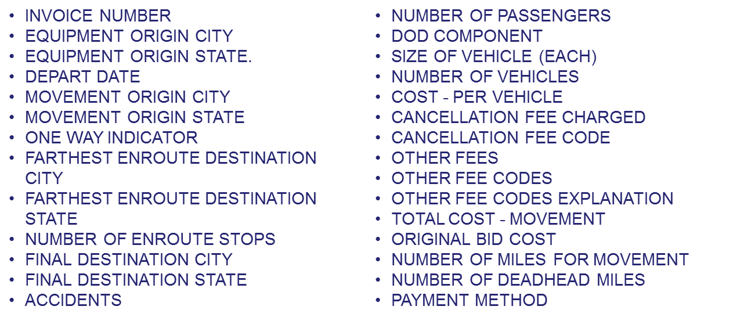
Required Data Elements
Data elements required for CMR:

Slide 16
Main Menu

Slide 17
Importing a CSV file
Select “Import CSV File”

Slide 18
Importing a CSV file (continued)
The CSV file must consist of the following 27 columns in this order:
Column | Field Name | Format/Size
A | USDOT ID Number | Text (20)
B | Invoice Number | Text (25)
C | Equipment Origin City | Text (50)
D | Equipment Origin State | Text (2)
E | Departure Date | Date (10)
F | Movement Origin City | Text (100)
G | Movement Origin State | Text (2)
H | One Way Trip | Text (1)
I | Number of Enroute Stops | Numeric (3,0)
J | Final Destination City | Text (100)
K | Final Destination State | Text (2)
L | Number of Passengers | Numeric (6,0)
M | DoD Component | Text (1)
N | Vehicle Size(s) | Text (100)
O | Total Vehicles | Text (100)
P | Cost Per Vehicle | Text (100)
Q | Cancellation Fee | Numeric (12,2)
R | Cancellation Reason | Text (1)
S | Other Fee | Numeric (12,2)
T | Other Fee Reason | Text (7)
U | Other Fee Explanation | Text (100)
V | Total Movement Cost | Numeric (12,2)
W | Original Bid Cost | Numeric (12,2)
X | Movement Miles | Numeric (9,0)
Y | Deadhead Miles | Numeric (9,0)
Z | Payment Method | Text (6)
AA | Accident Occurred | Text (1)
For detailed descriptions of each column, See https://www.defensetravel.dod.mil/Docs/CMR_CSV_Data_Dictionary.pdf or Appendix A.
A sample file template can be downloaded from https://www.defensetravel.dod.mil/Docs/CMR_CSV_Template.csv
Note: The file will not import successfully if it is not formatted correctly. Please review the CSV file before importing.

Slide 19
Importing a CSV file (continued)
Click “Browse” to locate the CSV file.
Once the file is selected,
Click “Upload” to begin importing.
Note: The file will not import successfully if it is not formatted correctly. Please review the CSV file before importing.

Slide 20
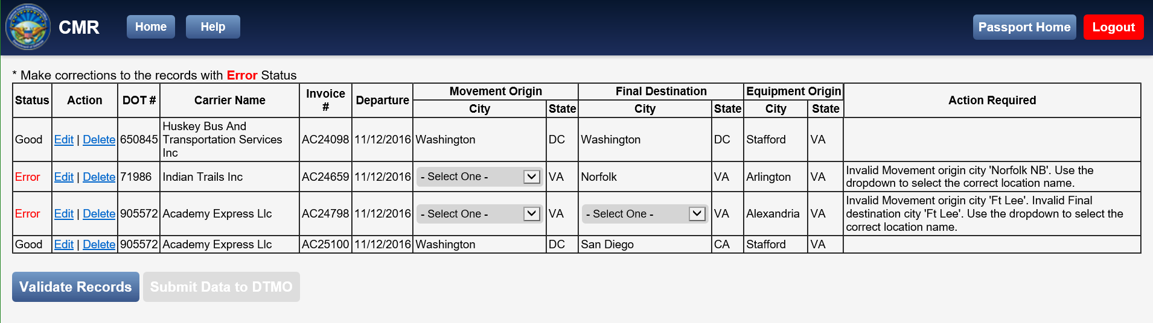
Importing a CSV file (continued)
Once a file is successfully imported it will display as the table below.
Each movement record is validated and give a status of “Good” or “Error”. Each record with a status of “Error” will indicate the “Action Required” in that column. Location errors can be corrected in the table using the dropdown menu. Other “Action Required” issues will require “Edit” .
Resolve each “Action Required” as necessary, then click “Validate Record”.
All records must show a status of “Good” before the batch can be submitted to DTMO.

Slide 21
Entering an Individual Movement
Select “Individual Movement”

Slide 22
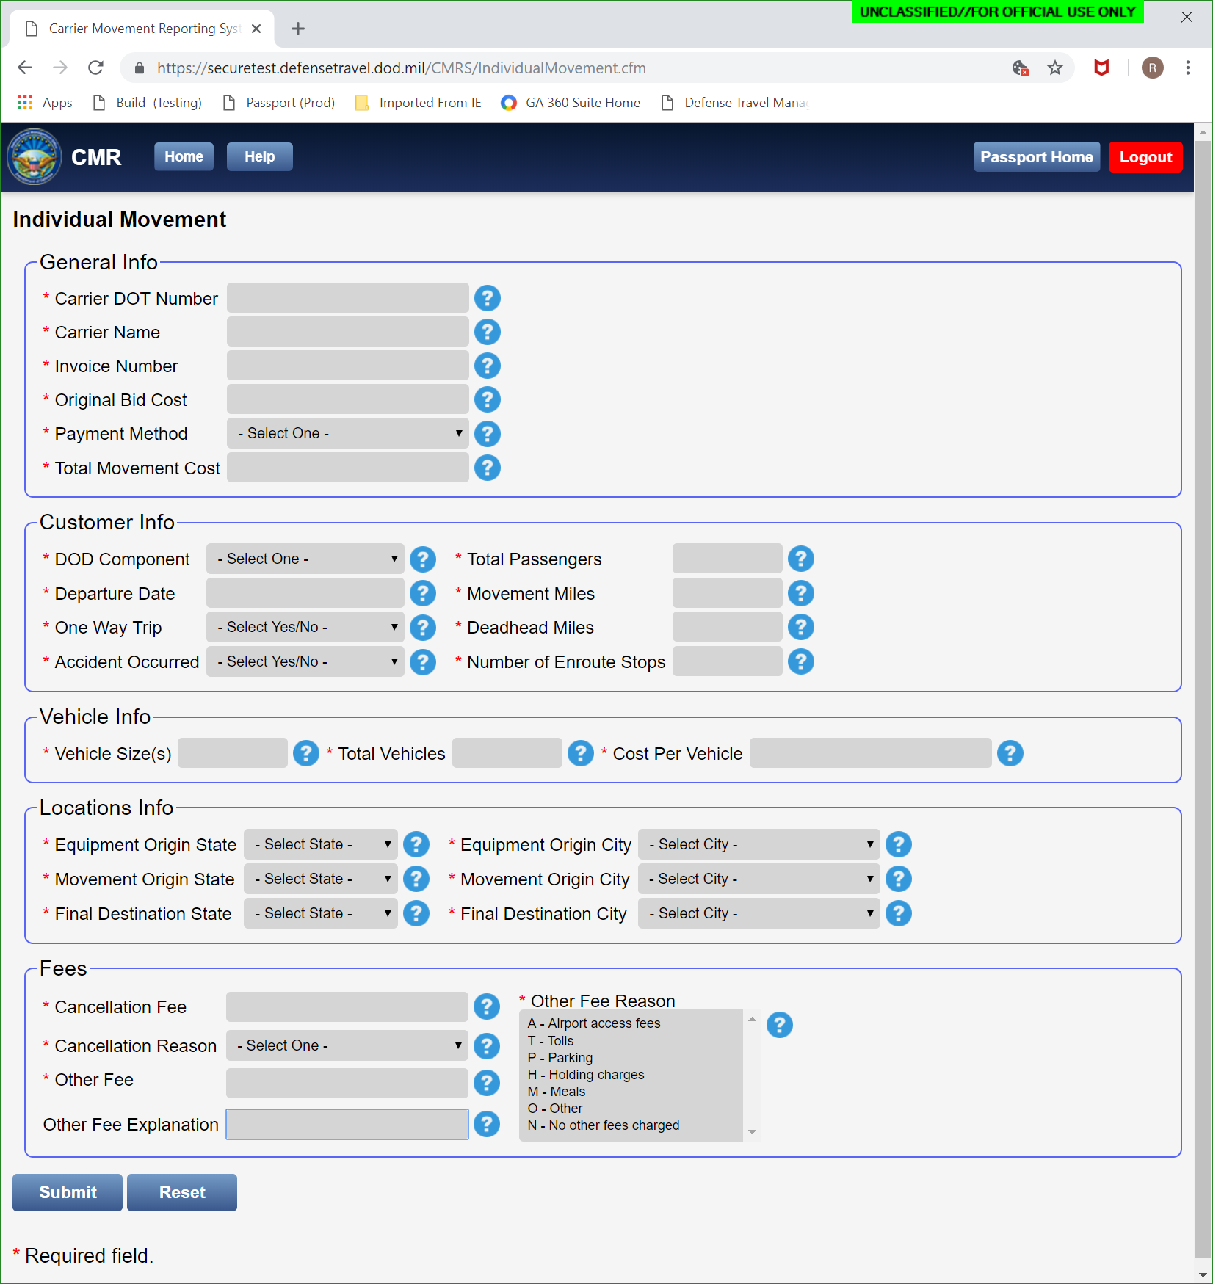
Entering an Individual Movement
Enter data in all * required fields.
The “?” help icon describes the input needed and the required format. Mouse over each “?” for input descriptions.
Once the movement record is complete, click “Submit”
If the record fails validation, follow the “Action Required” instructions to resolve the issue.
The record will be submitted to DTMO if all validation requirements are passed.
Click “OK” to continue.
Click “Home” to return to main menu.

Slide 23
Reporting “No Movements”
Select “Report ‘No Movements’”

Slide 24
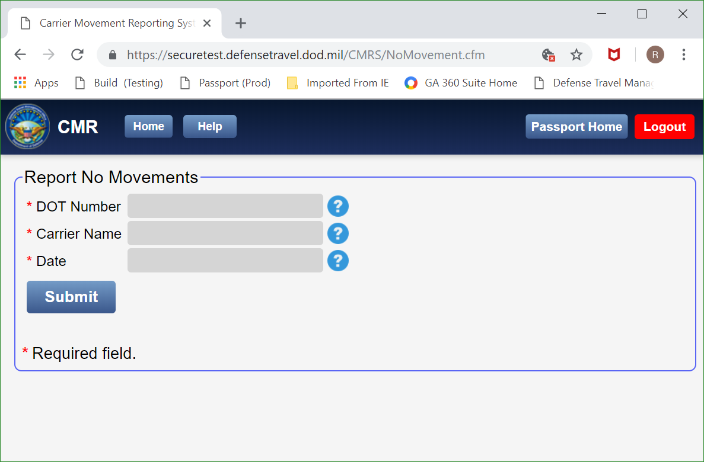
Reporting “No Movements” (continued)
Enter data in all * required fields.
The “?” help icon describes the input needed and the required format. Mouse over each “?” for input descriptions.
Once the record is complete, click “Submit”
If the record fails validation, follow the “Action Required” instructions to resolve the issue.
The record will be submitted to DTMO if all validation requirements are passed.
Click “OK” to continue.
Click “Home” to return to main menu.

Slide 25
CMR System Assistance
Hotline: 571-372-1300 / 571-372-1181 (Request Carrier Movement Reporting Assistance)
E-mail: dodhra.mc-alex.dtmo.list.movement-management@mail.mil Subject: CMR

Slide 26
Way Ahead
Rewrite of GOPAX completed by end of FY18
CMR testing with Carriers in April
New Agreement projected to be completed in Fall timeframe

Slide 27
Program Contact Information
DTMO website – www.defensetravel.dod.mil
DTMO Bus Program website - https://www.defensetravel.dod.mil/site/bus.cfm
Copy of the Military Bus Agreement
Approved Carrier List
GOPAX
Military Bus FAQs
Bus Program Email: dodhra.mc-alex.dtmo.mbx.military-bus-program@mail.mil
General inquiries: 571-372-1300
For emergencies/after normal duty hours, call the Travel Assistance Center (TAC) at 1-800-help1go (800-435-7146)

