Slide 1
HVAC Certification, Tools and Training

Slide 2
EPA Requirements
Ozone damaging refrigerants was agreed to be phased out at the Montreal Protocol in 1987
In 1992, a time line was established and certification required
Two categories of air conditioning systems was created – 608 and 609
Can not vent refrigerant to atmosphere
Must use EPA Approved equipment
Equipment must be registered with your regional EPA office

Slide 3
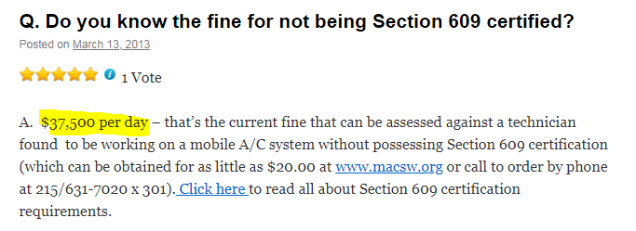
Fines for Violation

Slide 4
608 or 609
609 controls mobile air conditioning systems
608 controls stationary air conditioning systems
Unfortunately, it is not quite that simple

Slide 5
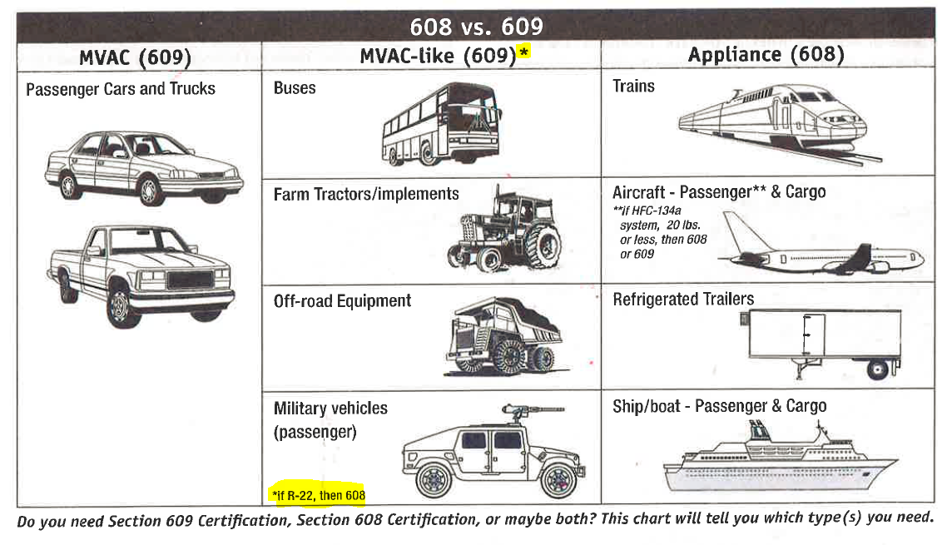
EPA Classifications

Slide 6
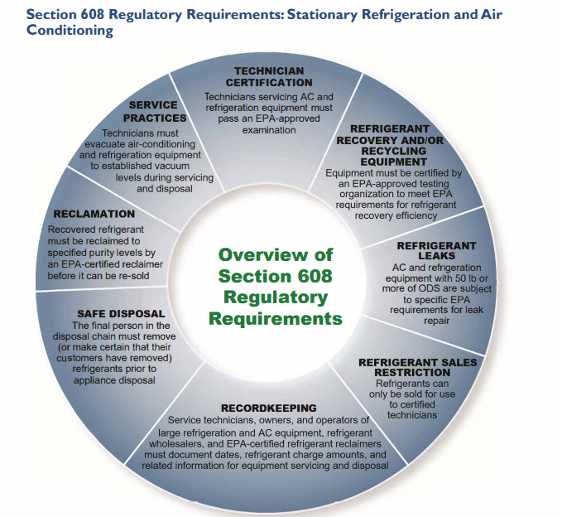
EPA 608 Requirements

Slide 7
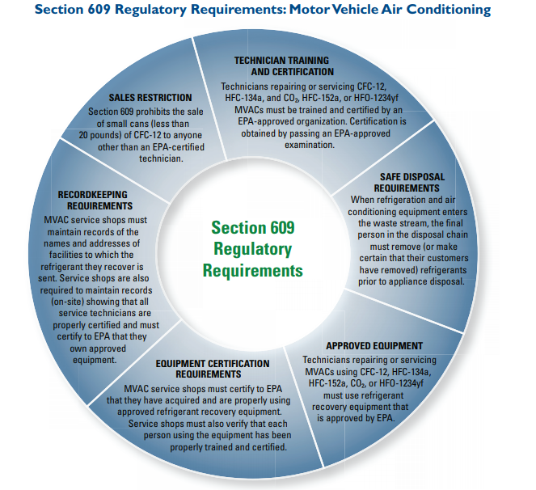
EPA 609 Requirements

Slide 8
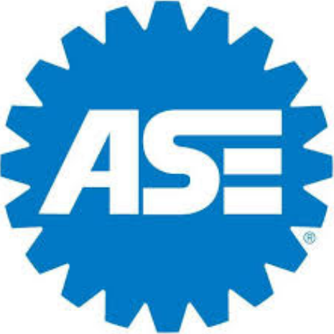
EPA 609 Technician Certification
Can be completed on line or as a mail in test
Open book test
Lifetime certification
Primarily designed for mobile air conditioning systems
Test costs @$20 per person

Slide 9
EPA 608 Technician Certification
Must be conducted by certified proctored
Closed book test
Lifetime certification
Core Knowledge required for all types
Type I – Small Appliances
Type II – Residential Systems
Type III – Low Pressure Vapor Systems
Universal – All Systems
Cost @$75 and up

Slide 10
Refrigerant Purchasing
January 2018 requires only certified technicians to be able to purchase refrigerant (H134a now)
Must be able to prove your company has at least one technician is certified
Larger volumes may require proof of 608 certification
Best Practice – Track purchases and usage

Slide 11
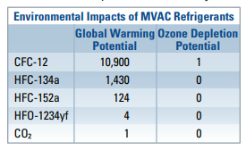
Current Refrigerants

Slide 12
Are You Using the Right Equipment?

Slide 13
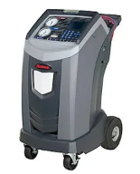
All in One Machines
Designed for automotive systems
Slow to evacuate
OK for recycling
Make sure you have extra tanks

Slide 14
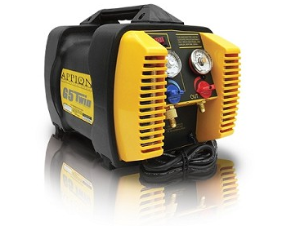
Appion G5 Twin Recovery Machine
Designed for commercial refrigeration
Can remove up to 6 pounds of refrigerant per minute
Costs @$750

Slide 15
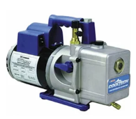
Vacuum Pump
6 to 7 cfm
Oil must be changed every job
Use vacuum pump oil and not POE oil

Slide 16
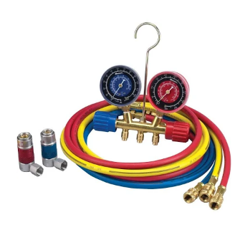
Manifold Gauges
Must be kept sealed when not in use
Easily knocked out of calibration
Not accurate for evacuation

Slide 17
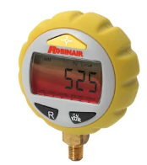
Micron Gauge
Much more accurate than a Manifold Gauge needle
1 inch of mercury on a Manifold Gauge equals 25,000 microns
Systems must be evacuated to 750 to 1000 microns
A must have to properly service HVAC systems

Slide 18
Are You Servicing Your Equipment Correctly?
Changing filters as required by the equipment manufacturer
Changing oil as required by equipment manufacturer
Leak testing manifold gauges and hoses

Slide 19
Refrigerant Quality
What are you putting back in?
Has it been fully recycled?
Is it mixed with other refrigerant?
Does it contain non condensable gas (nitrogen and air)?

Slide 20
Training

Slide 21
Proper Training
Where was training on HVAC systems completed?
How long was the training?
Was HVAC experience learned just from others?

Slide 22
What We Have Seen
Very little formal training
Training on automotive and truck systems only
Knowledge gained through trial and error
Knowledge gained from others who learned on their own

Slide 23
Normal OEM Training
Training on system used
Assumes solid HVAC knowledge already exists
Normally 2 to 3 days
You can not learn HVAC in this short of time

Slide 25
MCI Academy
Developed a HVAC Specialist program
4 weeks in length – not consecutive weeks
HVAC 101 – 3.5 days – Fundamentals and EPA Certification
HVAC 201 – 4.5 days – Major Components
HVAC 301 – 4.5 days - Service
HVAC 401 – 4.5 days – Troubleshooting

Slide 26
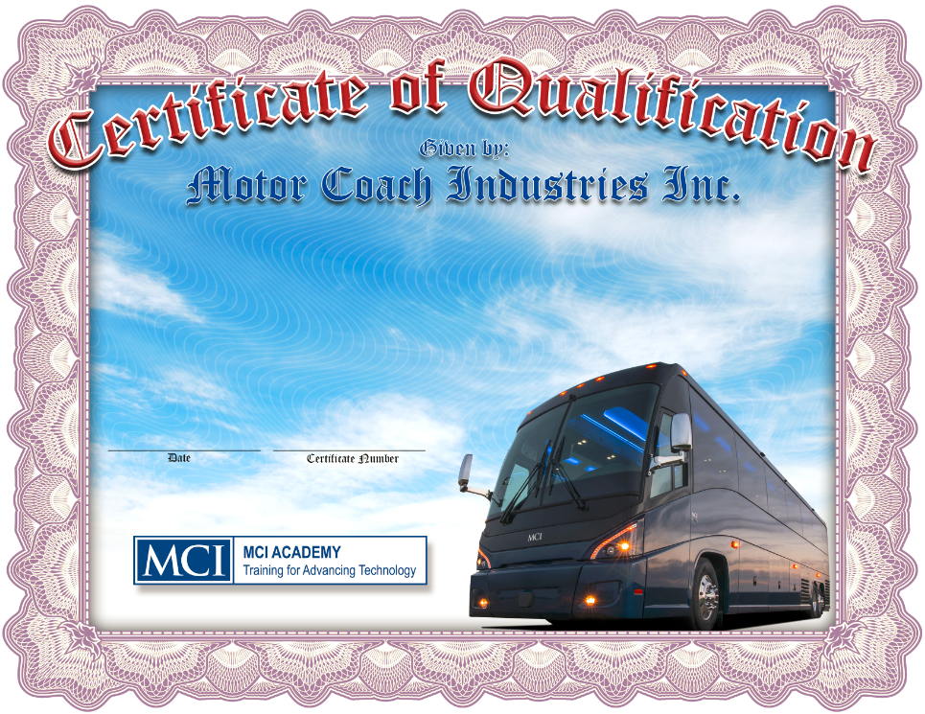
System Qualifications
LMS Courses, Classroom Sessions, Practical and Written Testing
16 different qualifications available

Slide 27
Qualifications Lead to Certificates
Technician Level 3
Preventive Maintenance Qualification
Tires and Wheels Qualification
MCI Air Systems Qualification
MCI Basic Steering Systems Qualification
MCI Basic Suspension Systems Qualification
Tire Pressure Monitoring Systems Qualification
Technician Level 2
Drum Brakes Qualification
Disc Brakes Qualification
Wheel End Systems Qualification
Antilock Brake Systems Qualification
MCI Basic Electrical Qualification
MCI Advanced Steering Systems Qualification
MCI Advanced Suspension Systems Qualification
Auxiliary Heating Systems Qualification
Technician Level 1
MCI HVAC Qualification
Advanced Electrical Systems Qualification

Slide 28
R
E
Master MCI Technician
E
Electrical Specialist Diploma
R
MCI HVAC Specialist Diploma
A
MCI Technician Level 1
C
MCI Technician Level 2
and
or
MCI Technician Level 3

Slide 29
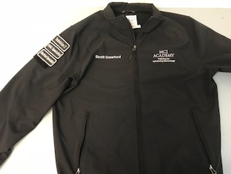
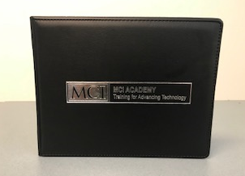
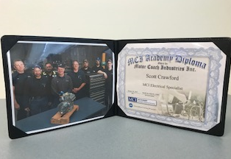
Graduate Recognition

Slide 30
Motorcoach Technician Apprenticeship Program
Notes:
Welcome to the MCI Academy On line training library. The topic you have selected is Emergency Evacuation Guidelines. These Guidelines are only general in nature because each situation may require different responses.

Slide 31
Summary of Credentials to be Earned
(16) System Qualifications
(3) Technician Level Certificates
Commercial Driver’s License
(2) Specialist Diplomas
EPA 608 and 609 certifications
Master MCI Technician certificate
Motorcoach Technician Journeyman certificate

