Slide 1
The Intercity Bus Security Grant Program & Associated Initiatives
2019 BISC Summer Meeting
Kerry L. Thomas
Chief, Transportation Infrastructure Security Branch (TISB)

Slide 2
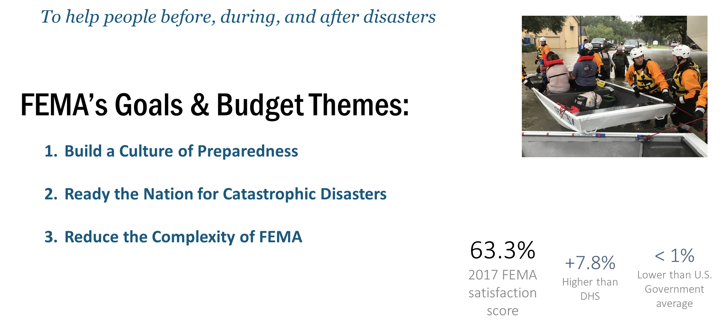
Brief FEMA Overview: Our Mission

Slide 3
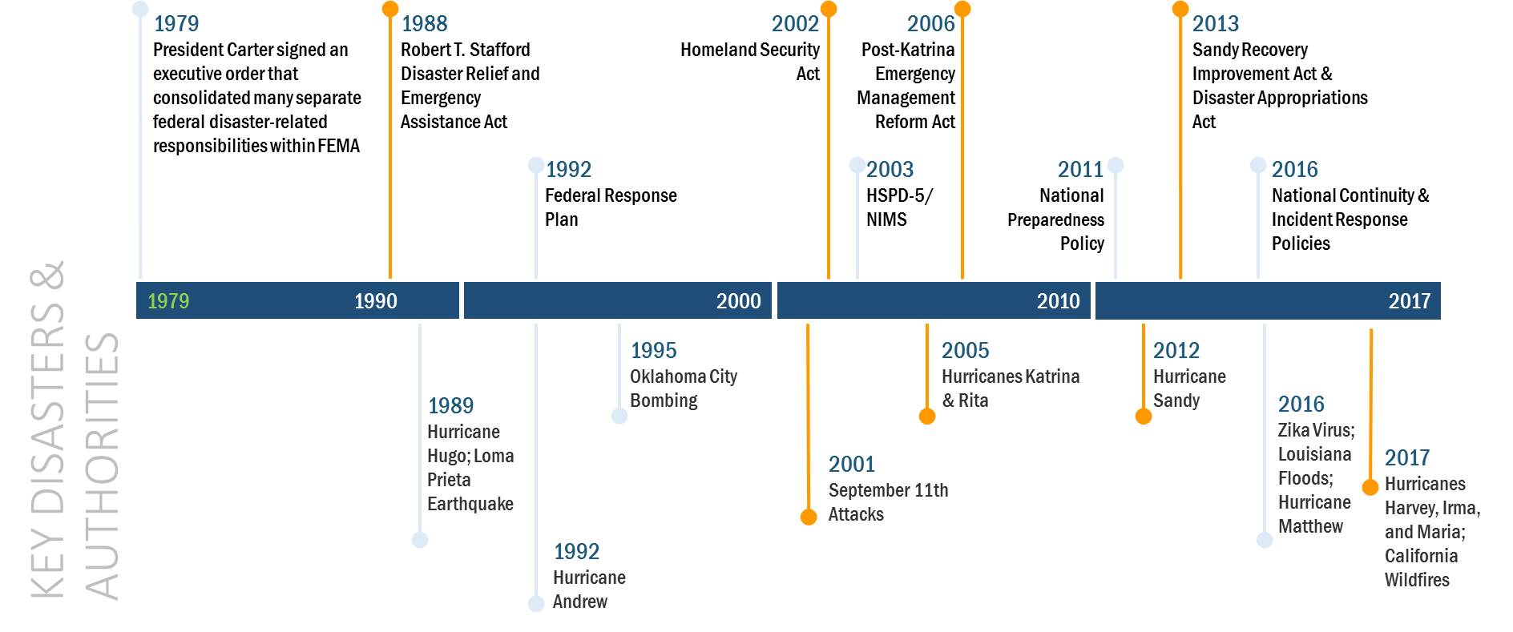
Our History

Slide 4
Our Organization

Slide 5
Transportation Infrastructure Security Branch
Overview
The Intercity Bus Security Grant Program is one of four funded grant programs within the Transportation Infrastructure Security Branch (TISB):
Transportation Infrastructure Security Branch
Transportation Infrastructure Security Branch (TISB)
Port Security Grant Program
(PSGP)
Transit Security Grant Program
(TSGP)
Intercity Bus Security Grant Program (IBSGP)
Intercity Passenger Rail
(IPR) Program

Slide 6
IBSGP Historical Overview
Fiscal Year Program$ | Amount
FY 2003 Intercity Bus Security Grant Program | $19,800,007
FY 2004 Intercity Bus Security Grant Program | $9,925,532
FY 2005 Intercity Bus Security Grant Program | $9,657,138
FY 2006 Intercity Bus Security Grant Program | $9,503,000
FY 2007 Intercity Bus Security Grant Program | $11,640,000
FY 2008 Intercity Bus Security Grant Program | $11,172,250
FY 2009 Intercity Bus Security Grant Program | $11,658,000
FY 2010 Intercity Bus Security Grant Program | $11,520,000
FY 2011 Intercity Bus Security Grant Program | $4,990,000
FY 2012 Intercity Bus Security Grant Program | $0
FY 2013 Intercity Bus Security Grant Program | $0
FY 2014 Intercity Bus Security Grant Program | $0
FY 2015 Intercity Bus Security Grant Program | $3,000,000
FY 2016 Intercity Bus Security Grant Program | $3,000,000
FY 2017 Intercity Bus Security Grant Program | $2,000,000
FY 2018 Intercity Bus Security Grant Program | $2,000,000
Total | $99,865,927

Slide 7
FY2019 Intercity Bus Security Grant Program (IBSGP)
Program Overview | FY 2018 | FY 2019
Purpose: The IBSGP provides funds to intercity bus service providers for the protection of surface transportation infrastructure and the traveling public from acts of terrorism. Eligibility: Funding is competitively awarded to operators who provide transportation via over-the-road buses (OTRB). Eligible OTRB operators must (1) provide fixed-route intercity bus transportation to a defined UASI jurisdiction; or (2) operate a charter bus service that provides a minimum of 50 trips annually to a defined UASI jurisdiction. | $2,000,000 | $2,000,000
Program Highlights
IBSGP program priorities were fully updated in FY 2019: National Priorities Enhancing the protection of soft targets Enhancing weapons of mass destruction (WMD) and improvised explosive device (IED) prevention, detection, response, and recovery capabilities Enduring Needs Effective planning Training and awareness campaigns Exercises
Notes:
7

Slide 8
FY 2019 IBSGP Timeline
02/15/2019
04/12/2019
05/29/2019
08/2/2019
09/30/2019
57 Days
45 Days
65 Days
FY 2019 Appropriation Enacted
Notices of Funding Opportunity (NOFO) Release
Applications submitted to FEMA
Final Allocations
Announced
Awards processed by September 30
*Note: NOFO release and award announcement timelines are Congressionally mandated.

Slide 9
IBSGP Associated Initiatives
Enhancing stakeholder engagement
  FEMA and ABA co-hosted a pre-award IBSGP industry call on April 18, 2019
  ABA hosted a FEMA site visit to the Union Station bus deck on April 24, 2019
  Active participation in industry events like the BISC Summer Meeting
Providing targeted grants management technical assistance
  FEMA and ABA will co-host a half day session on post-award grants management on August 20, 2019
Developing a risk assessment tool and associated planning templates
  Industry is asking for this and it also helps address an enduring challenge for FEMA… measuring the impact of programs like the IBSGP
    How do you measure something that hasn’t happened?
    How are we reducing risk to the nation’s transportation systems?

Slide 10
IBSGP Associated Initiatives (cont.)
Working with TSA, FEMA is developing a risk assessment tool tailored for use by over the road bus (OTRB) operators
  The OTRB Risk Assessment Methodology (OTRB-RAM) will provide a standard set of incidents which may be paired with operator assets to determine current risk in three areas:
    Buses
    Public Terminals
    Non-Public Facilities
  OTRB stakeholders will also be able to use the results of this risk assessment to identify security gaps and establish a plan for addressing them using standardized templates
  As security investments are made, their impact can then be measured against the established risk baseline

Slide 11
OTRB-RAM Current Status and Next Steps
A working model of the risk tool has been completed
In partnership with TSA and ABA, FEMA will conduct beta tests of the tool with OTRB stakeholders in the Summer of 2019
Once feedback from the beta tests has been reviewed and incorporated, FEMA will work with TSA and ABA to make the tool and associated planning templates available for use, possibly as early as the Fall of 2019

Slide 12
Questions?

