Slide 1


Safety Defect Definition, Investigation Process & Code of Federal Regulations (CFR) review at Motor Coach Maintance Conference
Ryan Rahimpour, Jon Harrison
06. 26. 2019

Slide 2

Introductions
Mission
ODI Re-Organization
Safety Defect Definition and Review
ODI Investigation Process
Example Investigation
Contact Information
Open Discussion
1
2
AGENDA
3
4
06. 26. 2019
5
6
7
8

Slide 3
#
Mission
Office of Defects Investigation (ODI)
Identify design or manufacturer defects relating to motor vehicle safety
Assure that defects are remedied effectively and promptly
Assure that information relating to investigations and recalls is made available to the public

Slide 4
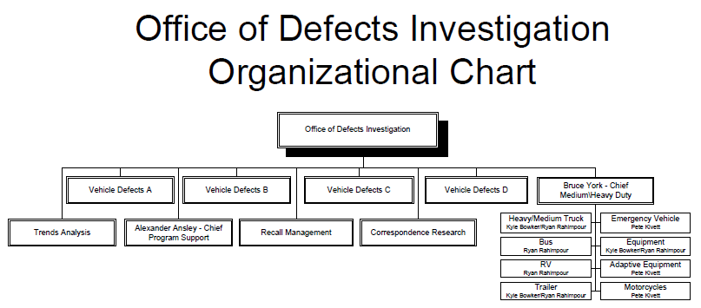

Slide 5
#
Safety Defect
What is a Safety Related Defect under the Safety Act?
The concept of a safety related defect under the safety act can be broken down into two components:
(1) Is there a defect? And if so, (2) does it relate to motor vehicle safety?
The Safety Act provides two relevant definitions:
“defect” includes any defect in performance or construction of a motor vehicle or motor vehicle equipment.
“motor vehicle safety” means the performance of a motor vehicle or motor vehicle equipment in a way that protects the public against unreasonable risk of accidents occurring because of the design, construction, or performance of a motor vehicle and against unreasonable risk of death or injury in an accident and includes non-operational safety of a motor vehicle.
"Unreasonable risk" is not defined in the Safety Act. Moreover, the definition of “defect'" is of limited help. For example, it does not define a defect in performance. Fortunately, court decisions in defect cases brought by NHTSA have helped define the scope of those terms.

Slide 6
#
Safety Defect vs. Compliance Issue
Non-Compliance Issue: (Pursed by OVSC) issue where a motor vehicle or covered motor vehicle equipment fails to meet one or more Federal Motor Vehicle Safety Standards (FMVSS) contained in 49 CFR Part 571.
Safety-Related Defect: (Pursued by ODI) any defect in performance, construction, a component, or material that results in an unreasonable risk of crash or an unreasonable risk of death or injury in an accident.
A safety-related defect may exist on a vehicle even though it meets all FMVSS requirements.
A safety-related defect includes nonoperational safety.

Slide 7
#
Design/Manufacturing Defect Examples
Inoperative windshield wipers
Cracked or broken wheels
Cracked or broken coupling devices
Cracked or broken suspension components
Brake component failures
Steering component failures
Turbo failures
ABS fault lights
Failed or broken mirrors
Fuel tank securement

Slide 8
#
Non-Defect - Maintenance Examples
Tires worn out
Brake pads worn out
Wheels bent or damaged from abuse
Fluid leak from a gasket connection
Damaged lighting

Slide 9
#
Depends
Fuel leaks
Frame cracks
Air lines abrading
Electrical wiring chafing
Ball joint failures
Stalling
Lighting failures
Cracks in leaf springs
Bearing seals

Slide 10
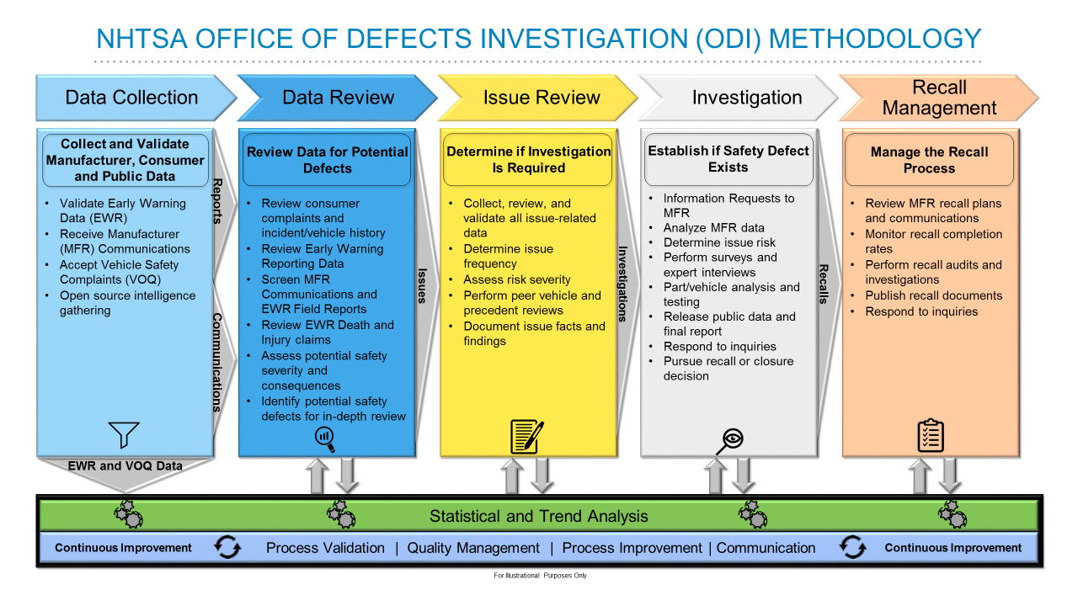






NHTSA OFFICE OF DEFECTS INVESTIGATION (ODI) METHODOLOGY
Data Collection
Data Review
Issue Review
Investigation
Recall Management
Validate Early Warning Data (EWR)
Receive Manufacturer (MFR) Communications
Accept Vehicle Safety Complaints (VOQ)
Open source intelligence gathering
Review consumer complaints and incident/vehicle history
Review Early Warning Reporting Data
Screen MFR Communications and EWR Field Reports
Review EWR Death and Injury claims
Assess potential safety severity and consequences
Identify potential safety defects for in-depth review
Collect, review, and validate all issue-related data
Determine issue frequency
Assess risk severity
Perform peer vehicle and precedent reviews
Document issue facts and findings
Information Requests to MFR
Analyze MFR data
Determine issue risk
Perform surveys and expert interviews
Part/vehicle analysis and testing
Release public data and final report
Respond to inquiries
Pursue recall or closure decision
Review MFR recall plans and communications
Monitor recall completion rates
Perform recall audits and investigations
Publish recall documents
Respond to inquiries
Collect and Validate Manufacturer, Consumer and Public Data
Review Data for Potential Defects
Determine if Investigation Is Required
Establish if Safety Defect Exists
Manage the Recall Process
Reports
Issues
Investigations
Recalls
Communications
EWR and VOQ Data
Statistical and Trend Analysis
Process Validation | Quality Management | Process Improvement | Communication
Continuous Improvement
Continuous Improvement
For Illustrational Purposes Only

Slide 11
Investigation Initiation
(Data & Issue Review)
#
Screening
Safety Related (L1 - 100% Review) Assign Appropriate Risk Matrix
Frequency Indicators (L2) Assign Invalidated Matrix Risk and Frequency Level
Assemble & Review Complaints & EWR data
Prioritize the Issue
Understand the Safety Consequence & Trend
Validate Complaints
Peer Vehicle Comparison
Review Current & Past Activity
Document and Summarize Information Gathered
Apply Appropriate Validated Data to Risk Matrix and Make Investigation Decision
Brief Management for Investigation Approval

Slide 12
#
Investigation Steps
Opening Resume
Complaint Analysis
Send Information Request Letter (IR)
IR Response Turn Around - 6 to 7 Weeks
Inspect Vehicles
Data Analysis
Testing
Survey
Evaluate IR Response
Communication with Manufacturer
Follow Up IR, Peer IR Letters
Recall, Close, or Legal
Post Investigation

Slide 13
#
Recalls
NHTSA Receives over 1,000 recalls (defect & non-compliance) per year.
These recalls affect nearly 80,000 products per year.
Of the recalls received, approximately 10% are influenced.
Influenced vs. Voluntary
Review Manufacturer recall plans and communications
Monitor recall completion rates
Perform recall audits and investigations
Publish recall documents
Respond to media inquiries
Consumer complaints and other data received by NHTSA are monitored to ensure recalls have an adequate scope and an effective remedy.

Slide 14
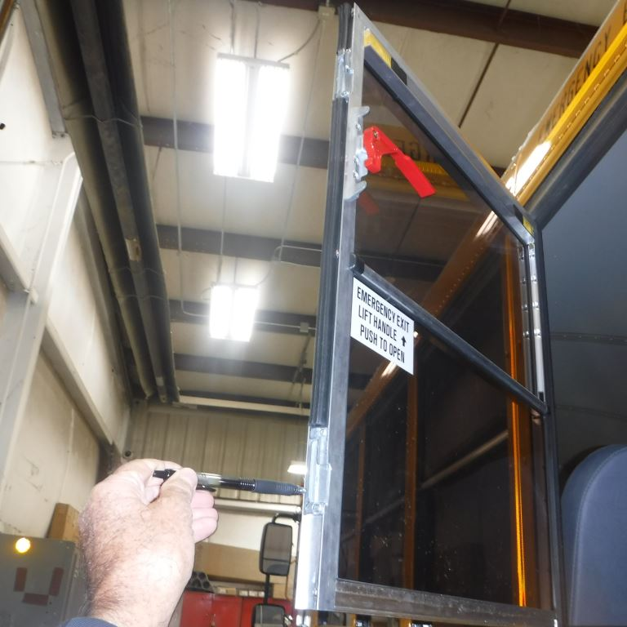
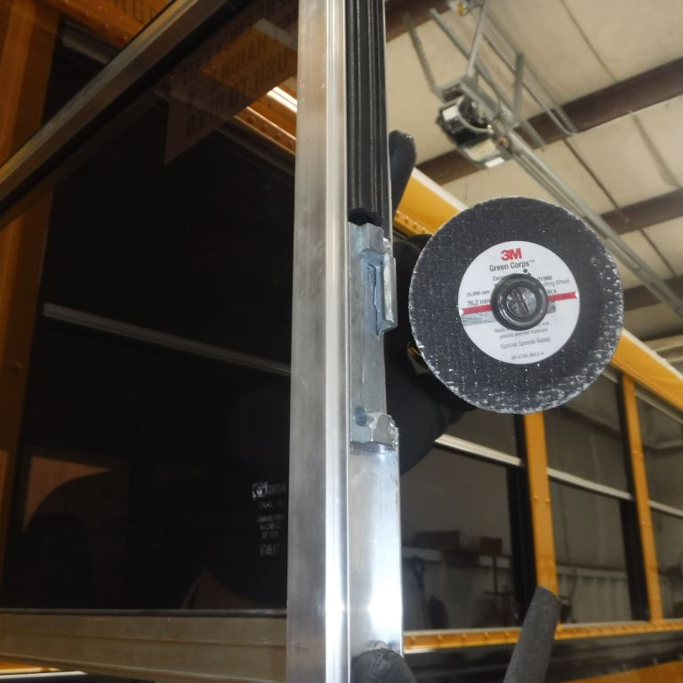
#
Example Investigations – Non Compliance
Issue: Emergency egress window very hard to open
Cause: Window release mechanism binding
Result: Recall 18V-4943 – 7,859 School Busses
  Mechanism does not conform to FMVSS 217. S5.3.2.1 This requirement indicates no more than 89 Newtons (20 pounds) of force shall be required to release the exit

Slide 15
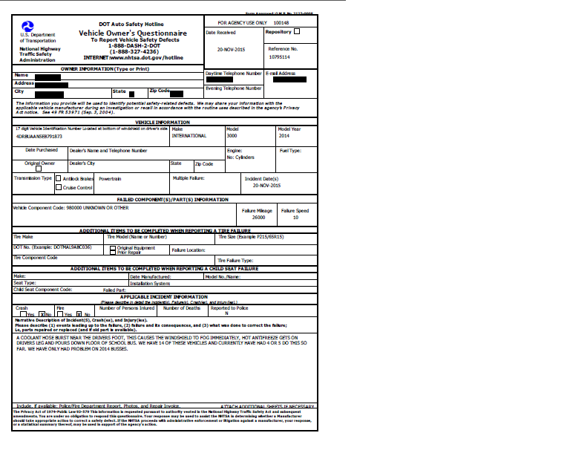
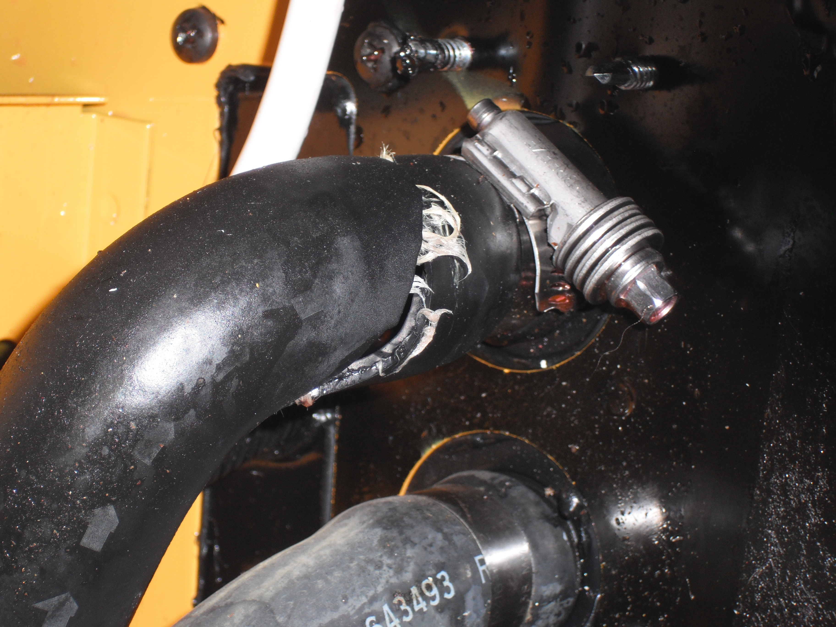
Example Investigations – Vehicle Owner Questionnaire
Issue: Heater hose rupture at drivers feet
Cause: Hose fatigue resulting in split
Result: Recall 16V-837: 20,673 School Buses
888-327-4236

Slide 16
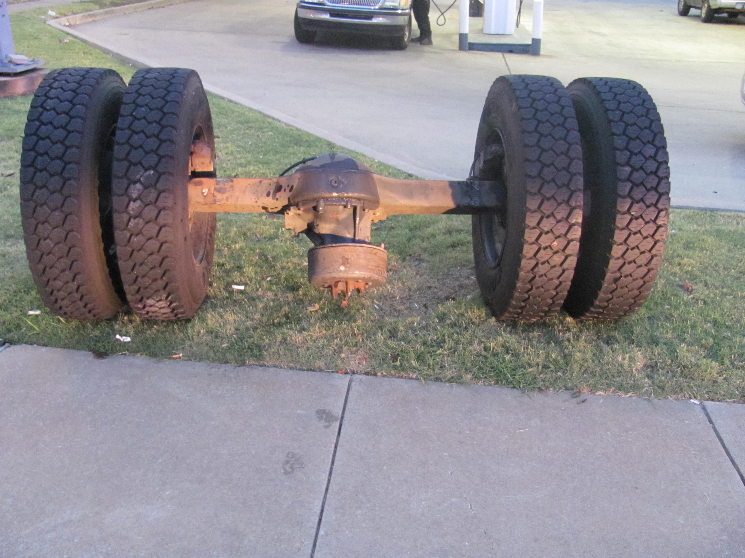
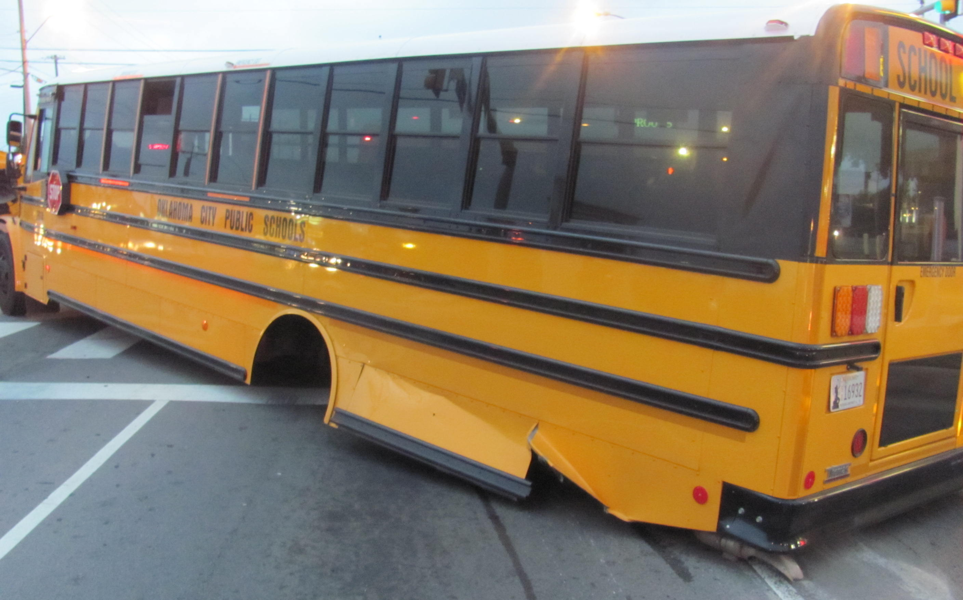
Example Investigations – Potential Safety Issue
(Death/Injury EWR Report)
Issue: Loss of Rear Axle
Cause: Under torque axle U-bolts
Result: No recall due to improper repair performed by a non-dealer facility
888-327-4236

Slide 17
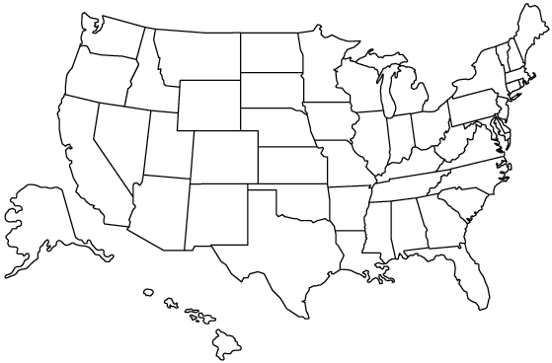
ODI Statistics
Uninfluenced Recalls 840 / yr
28.9 M Vehicles, Equipment, Child Seats, and Tires
Influenced Recalls 60 / yr:
13.7 M Vehicles, Equipment, Child Seats, and Tires
Investigations:
~ 40 / yr
Issues Screened: ~500 / yr
Complaints: ~ 80,000 / yr
Communications: ~ 20,000 / yr
EWR D&I: ~ 11,000 / yr
EWR Foreign Campaigns: ~ 240 / yr
US Vehicles: ~ 269 Million
CY 2017 data

Slide 18
Information From CMV
ODI does not receive a proportionate number of complaints from the Commercial Motor Vehicle (CMV) industry.
Vehicle Populations:
  268, 799 Million Automobiles
  9 Million Trucks & Buses
  3.52% of Pop. are CMV
Complaints Received (Annually):
  80,000 Automobile Complaints
  600 CMV Complaints
  Only 1.38% of Comp. are CMV
CY 2016 Data

Slide 19
Potential Causes & Concerns:
Fleets and drivers not aware of NHTSA/ODI
  ODI is not made aware of safety defects resulting in unsafe vehicles traveling the roadways.
Fleets work directly with manufacturers
  Only the fleet that has leverage with the manufacturer gets their vehicles repaired. Many other vehicles may still be on the road with a safety concern that could result in a crash (potentially involving you or your family).
Difficult for fleets to file complaints on multiple vehicles
  Fleets are discouraged from filing complaints due to time constraints and aggravation.

Slide 20
Solutions:
Increase ODI outreach efforts within the trucking/busing industry.
  Attend trucking/busing trade shows
  Develop partnerships with trucking/busing carriers/fleets
  Advertise on trucking radio channels like SIRIUS
Increase awareness of the problems associated with only informing the manufacturer of a defect.
Incorporate a new complaint form design that would make it easier for fleets to enter multiple vehicles.

Slide 21
What can you do to help?
If you become aware of a design or manufacturing safety defect on a CMV contact ODI:
888-327-4236
SaferTruck.gov
  Ryan.rahimpour@dot.gov
  202-366-8756
  You or someone you know could be injured or killed as a result of an un-reported safety defect on a truck or bus.

Slide 22
Questions:
Thank you for working together to keep our roads safer!

