Slide 1

Prevost Air System Maintenance

Slide 2
Prevost offers the solutions
you need – now and for
the future – to ensure your
coach is clean and safe for passengers and drivers alike allowing you to offer them
peace of mind.
Notes:
When we launched Clean & Care back in April & we never imagined we would be where we are today!
Clean and care, it is not a one size fits all solution for every customer,
This is a living document and is updated on a regular basis with new solutions to market concerns.
Be sure to visit prevostcar.com for regular update.

Slide 3





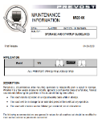












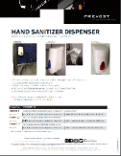





Clean & Care Status
Support to customers released:
Extended Warranty
Cleaning procedure
Storage procedures
Social distance seat layouts
MERV Filtration
Ready To Go
Online Training
Q&A Weekly calls
25 Solutions
Notes:
Again, not a one size fits all, if we start at the top Extended warranty,
(then follow key points)
These solutions range from something as small as a educational decals to PPE, driver and passenger distancing solutions and polycarbonate protection barriers.
MI20-09A, Gives you recommended cleaning & disinfecting procedures
MI20-08A STORAGE AND STARTUP GUIDELINES / 72 point inspection to get your coach back on the road

Slide 4

PTI online ready when you are
Notes:
Fantastic opportunity for customers to take advantage of.
Our maintenance and storage guidelines is complemented by a step by step online program
Driver familiarization, Operators have been setting idle, A refresher on Dash controls, WCL operation and general walk around is a great tool.

Slide 6
Notes:
Again, airflow is key and works to our advantage
The placement of the devices is critical to proper performance.

Slide 7
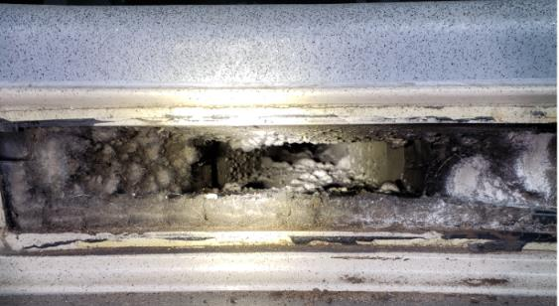
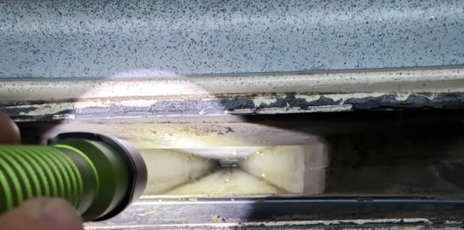
Stepwell Return Duct H3-45
BEFORE
AFTER
Notes:
As you can see the before and after pictures speak for themselves.
This cleaning was done in June 2019 after complaints of poor air flow. The coach is a 2010 and had about 250,000 miles on it at the time.
The customer reported a marked improvement following this cleaning.
In our customer trainings we somewhat jokingly refer to this as the coach’s very own central vacuuming system. Why you might ask? Well when the cleaners are in the bus they have the HVAC on, this duct is under suction and anything they sweep onto that first step gets sucked right into the return.
There are a couple of ways to clean these ducts out. The first being to take a shop vac and add extensions as needed. The other would be to install a sacrificial filter on the evap, run the A/C and push all of the accumulated dust, dirt, hair, etc. to the evap since that is the next place that will need to be cleaned anyway.

Slide 8
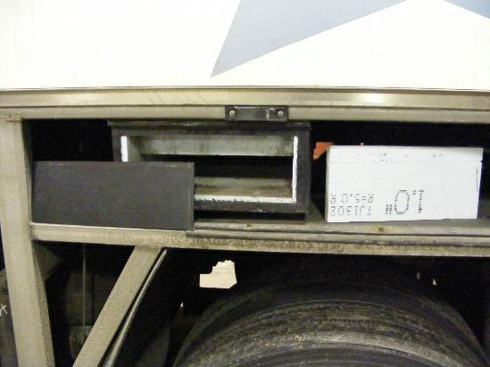
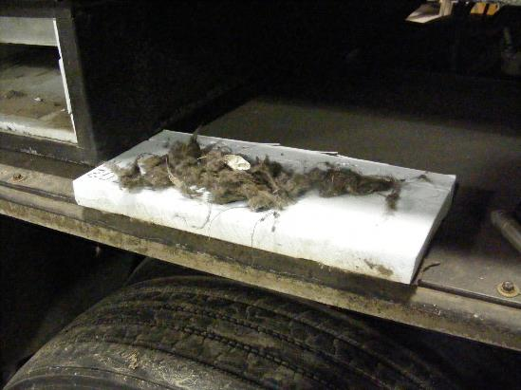
Cleaning the Return Air Ducts H3-45
Notes:
The rear return duct presents a little bit more of a challenge, but nothing that is insurmountable.
After removing the LR fender you will be looking right at the duct. You can easily cut an access with panel with a utility knife into the plastic. Leave at least a 1” lip around the outside so that you can secure a patch plate. Once you have the cut out removed you will be able to see what has accumulated. If it is an older coach, you may find some insulation has come loose too. This can severely restrict air flow if left unaddressed.
Now might be a good time to remind you about proper PPE. Safety Glasses and GLOVES are a must! Remember everything that is accumulated has come from the passenger cabin, and well…you get the idea.
Reach up into the opening and you will find the return air temp sensor. If it is clogged up with debris it can give erroneous temperature readings and have a negative effect on HVAC performance.

Slide 9
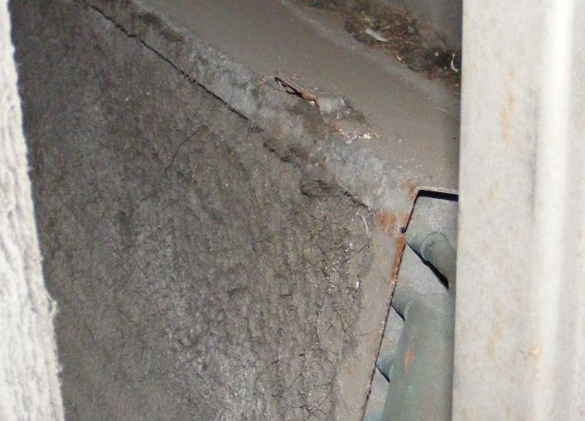
Evaporators should never wear a sweater!
Notes:
The evaporator should never wear a sweater. Just because it gets cold, doesn’t mean it needs extra insulation.
The main purpose of the evaporator coil is to transfer heat from the passenger cabin into the refrigerant that is coursing through it. If the coil is dirty this means that you will be getting poor heat transfer. This means that the heat you are trying to remove, will still be there.
Remember the way that A/C works is that it takes heat from an area where it is objectionable i.e. the cabin, and moves it to where it is not objectionable, i.e. the outside air.
Just cleaning it from this side is not enough. To properly clean this core it needs to be reversed flushed. To do this you will need to remove the blower motor assembly and the heater core. From there you can use low pressure water to clean out the core. A cleaning agent may also be necessary depending on how dirty the core is.

Slide 10
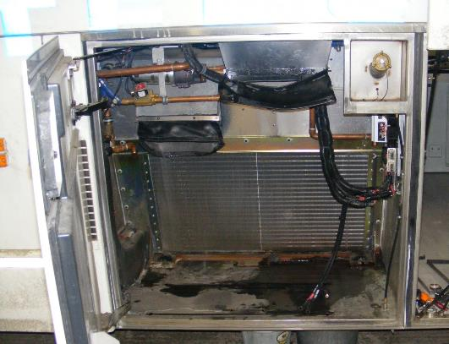
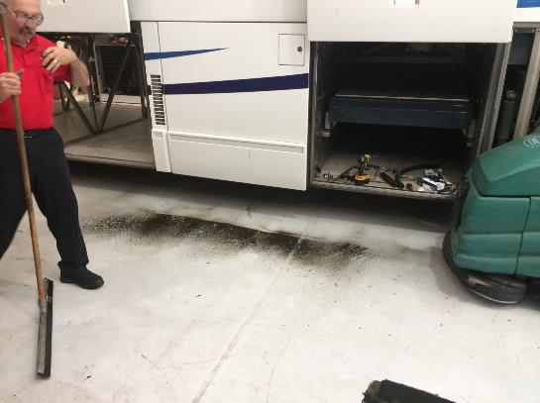
Cleaning the Evaporator Core
Notes:
In the left hand picture we can see what just one half of the core looks like after cleaning.
As you clean the core the dirt will drain out the bottom of the evap compartment floor. Have you floor cleaner and squeegee ready. In this particular example, the coach was about 6 years old. The amount of dirt on the floor represents only about 10% of what we were able to remove from this particular coach. This particular coach was done as part of a training class. We took before and after readings of various temperatures and pressures in the system to help reinforce the necessity of this procedure.
Before reassembling, now would also be a good time to clean the heater core as well. In addition be sure to inspect the squirrel cages to ensure that the fins have not become caked with dirt and debris.

Slide 11

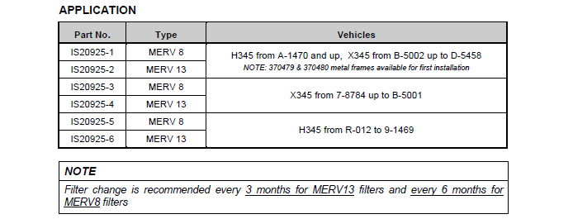
Check Your OEM Tech Publications Site

Slide 12


Slide 13

PREVOST TOOLS APP
Notes:
If you’re not taking advantage of the Prevost APPS you should be, puts critical information at your drivers and techs fingertips.

