Slide 1
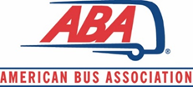
Government Affairs and Policy Report
2024 Spring Meeting of the ABA
Board of Directors
May 7, 2024
Waldorf Astoria
Washington, D.C.

Slide 2
Accomplishments
Legislative
FY 2024 Funding for Intercity Bus Security Grant Assistance - $1.8 million; FY 2025 submissions
Rural transportation hearing before House T&I Committee, March 21
Regulatory/Administrative
Filed comments/requests in 9 different federal and state regulatory actions; Tracking various federal regulatory/administrative proceedings covering multiple agencies
GHG Phase 3 –
CFC Roland Berger Study – ZEV infrastructure
Monthly GAP updates – published every month
State/Assn Activities
NYC tolling – supported local efforts, some progress
2

Slide 3
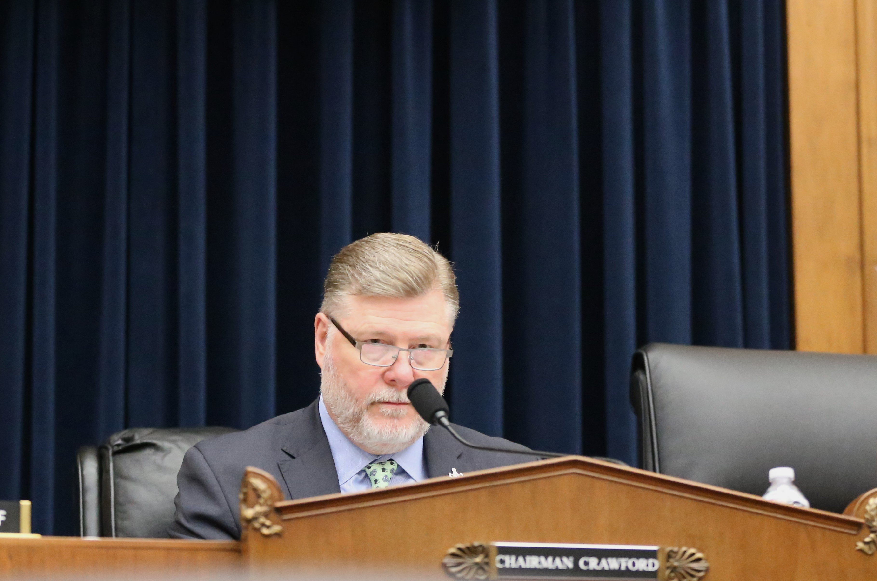
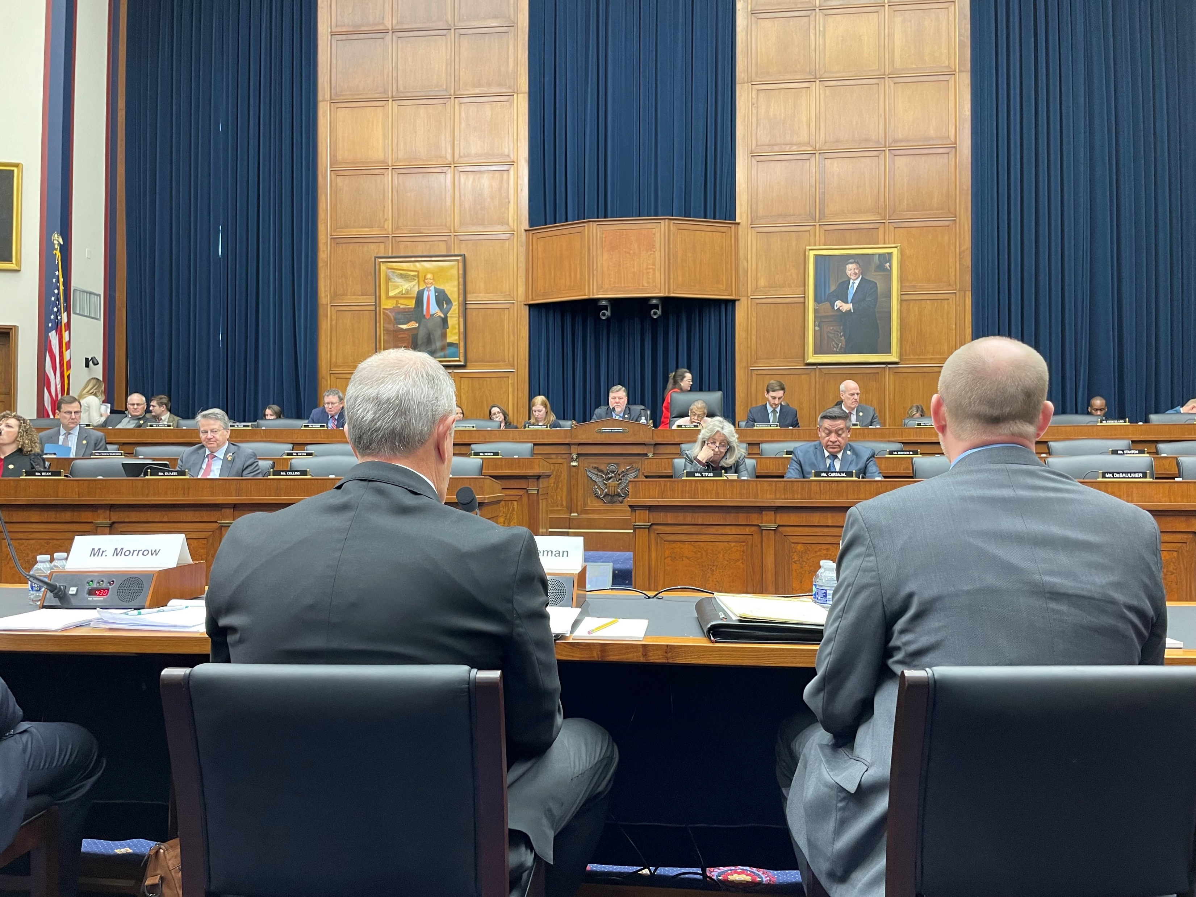
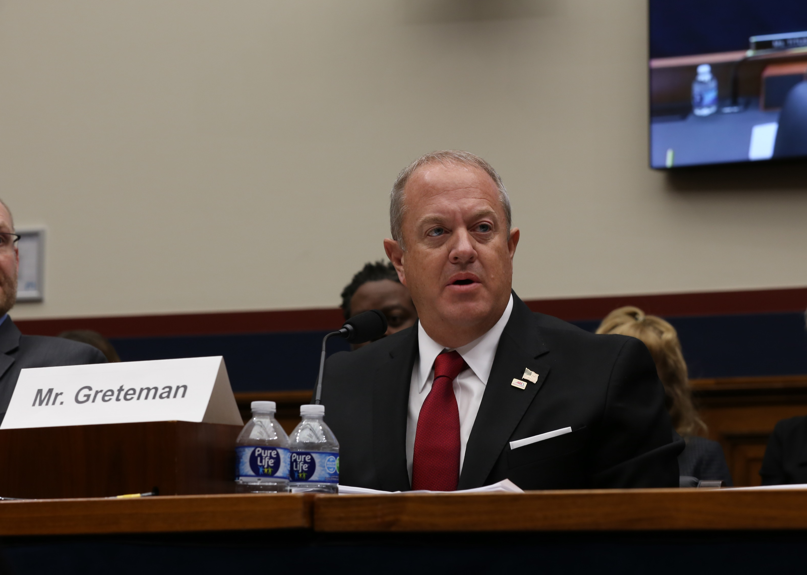
Washington Update
MARCH 21ST – T&I SUBCOMMITTEE HEARING
Rural Transportation Challenges: Stakeholders Perspectives
Access issues
Funding
Infrastructure & resources
Emissions and ZEV challenges
Tolling/congestion mitigation programs
3

Slide 4
Washington Update
2024 - CONGRESS TO DATE
V.
CONGRESS:
FY 2024 Funding Completed; initiating FY 2025 process
Avoided even partial shutdown
Foreign Aid Funding
Retained Speaker, D’s pledge
Bipartisan functioning, somewhat
HOUSE:
Members leaving early; disillusionment
Continued threats on Speaker’s seat
SENATE:
McConnell departure - loss of institutional knowledge
BILLS:
Tax bill not moving
3

Slide 5
Washington Update
WHAT’S LEFT?
FY 2025 Funding
12 Appropriation Bills, expect a CR
Bus Security Grants
NPS Park Fees
FAA reauthorization?
12 Appropriation Bills, CR
Bus Security Grants
NPS Park Fees
Defense Authorization (NDAA)?
Tax Package?
Not Likely
No CERTS fix
100% Bonus Depreciation/Sec. 163 v. Enhanced child tax credit
3
Notes:
FAA – currently extended to March 8
Sec. 163 – business interest limitation – interest expense deductibility

Slide 6
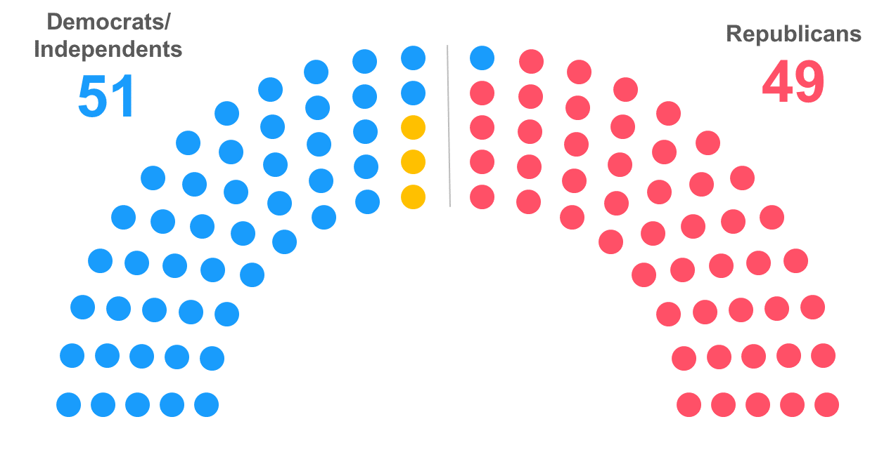
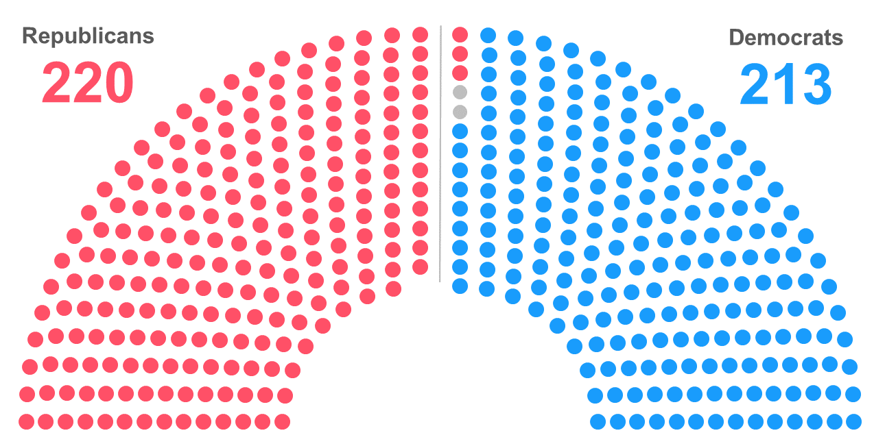
Current Balance of Power in the 118th Congress
2024 – Federal Election Status
Senate
House
217
213
5– vacancies
(4-Rs; 1 D)
Notes: As of Jan. 8. The yellow dots in Senate graphic reflect three independents who align with Democrats. Gray dots in the House graphic represent two vacancies caused by the expulsion of George Santos (R-N.Y.) and resignation of Kevin McCarthy (R-Calif.). Rep. Bill Johnson (R-Ohio) announced his resignation effective Jan. 21, while Rep. Brian Higgins (D-N.Y.) said he would resign early this year.
Notes:
Vote on 4/30 replaced a D with a D (Buffalo, NY) – making it 213-Ds to 217-Rs, now R’s can only lose 1 – vote, to move partisan legislation
25 D’s retiring or seeking other office; 22 R’s retiring or seeking other office
10 - who died, resigned or expelled; 4-Ds (currently 1- vacant) and 6 R’s (1 replaced, one flipped, 4 vacant)
Elections:
Senate – 34 seats up for election, R’s well positioned to retake the Senate (need a net gain of 2 seats)
- 23 Ds up; 11 Rs up
- of 23 D seats, 14 expected to stay D; 1 likely to remain (MD); 3 lean D; 4 are toss ups; and one is expected to flip (WV);
- of 11 R seats, 9 expected to stay R; 2 likely to remain R (TX, FL)
The number of retirements is not unusual. What is unusual, is the number of retirements that are coming in the middle of a Congress," Green said. "It speaks in part to how deeply unhappy House Republicans are with being in Congress. They would rather just bail and not even fulfill their two-year obligation to their constituents than put up with being in the chamber any longer."

Slide 7
2024 – Federal Election Status
Congressional Races
U.S. SENATE
U.S. HOUSE OF REPRESENTATIVES
- D-control (48 seats, joined by 2-I’s, and VP);
- R’s have 49 seats
- 34* seats up (~1/3 of Senate),
- D/I’s defending 23
- 10 Senators death/resign/not running, 7 are Ds
- R’s started with 222, now down to 217 (2-vote margin)
- D’s are now at 212
- 6 vacancies
- All 435 seats up for election
- 53 retire/other office (25-D; 23-R)
- 9 resignations (3-D/6-Rs)
- 1 expulsion
3
Notes:
Vote on 4/30 likely to add a D – making it 213, then can only lose 1 - vote
Total – 53; 25 D’s retiring or seeking other office; 23 R’s retiring or seeking other office
10 - who died, resigned or expelled; 4-Ds (2 replaced, 2 vacant) and 5 R’s (1 replaced, one flipped, 3 vacant)
U.S. Senate: 10; 7-Ds (Stabenow, Cardin, Carper, Feinstein, Manchin, Sinema, Menedez?); 3-Rs (Braun, Sasse, Romney). GOP does see a chance to retake Seante
U.S. House: retirements/seeking other office (22-D’s/17-R’s); 3 resignations (1-D/2-Rs, 1 to take place in Feb, March); 1 expulsion (special election 2/13/24)
Read: House – a lot of frustration, particularly for GOPs, moderates being pushed out/leaving. Also, chairman term limits on House GOP side, driving members away

Slide 8
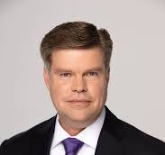
2024 – Federal Election Status
Presidential Race
DEMOCRATS:
REPUBLICANS:
INDEPENDENT AND THIRD-PARTY
UNKNOWNS:
Biden
Williamson
Palmer
Trump
Kennedy
West
Stein
TBD
Notes:
- Joe Biden, Marianne Williamson, now added Jason Palmer (businessman, tied Biden in American Samoa) – Dean Phillips dropped out
- Donald Trump, Ryan Binkely, Chris Christie, Ron DeSantis, Nikki Haley, Asa Hutchison, Vivek Ramaswamy
- RFK, Jr, Cornel West, Jill Stein

Slide 9
Regulations/Administration
DOT
OST: ADA/permanent seating
FMCSA: Speed Limiters, CDL Requirements, Safety Fitness, CA MRB, AEB
FTA: HOS rules for transit operators, 5311 Circular
NHTSA: AEB
FHWA: GHG targets
EPA
OAR: GHG – Phase 3 (ZEVs)
CARB waiver requests for Omnibus NOx and ACF rules
DOL
WHD: Overtime pay thresholds (non-driver)
OSHA: Heat std, outdoor workers
DOI
NPS: Commercial Use Authorizations registration system; fees
DHS
FEMA – Simplifying preparedness grant process; FY 2024 IBSGP grants
Treasury
FinCEN: BOI Reporting
NLRB
Rule and Decision on organizing labor unions
Joint Employer
5

Slide 10
Regulations/Administration
RULE/POLICY UPDATES
Treasury/FinCEN: BOI Rule - Effective Jan. 1, 2024
DOL/WHD: OT threshold rule – Effective July 1, 2024
EPA: GHG Phase 3 – Effective June 21, 2024
DOT/FHWA: GHG targets – Effective Jan. 8, 2024
-----------------------------------------------------------------------------
DOT/FMCSA: Speed Limiters SNPRM – Anticipated May
DOT/FMCSA: CDL Requirements Final Rule - ?
DOT/FTA: 5311 Program Circular Notice – Comments due June 3, 2024
9

Slide 11
NYC Tolling Plan
MTA approved tolling plan 3/27/24; Tolling starts:
June 20, 2024
SUMMARY OF BUS EXEMPTIONS
Commuter, transit, and intercity buses – open to the public and with fixed routes
School buses contracted with NYC’s Ed Department
Commuter vans licensed with NYC Taxi & Limo Commission
**Charter and Tour buses are not exempt**
9

Slide 12
NYC Tolling Plan
Bus Exemptions
Must enroll in “Commuter Bus Exemption Plan” or CoBEP – application available on NY E-ZPass site
Commuter buses registered in NY, must provide NYSDOT Common Carrier Certificate/Permit
Out of State registered buses must provide:
State-issued authorization to provide bus service
Supporting documentation showing schedule and fixed route
Registration for each vehicle listed on the application
Valid EZ-Pass New York Business Account
9

Slide 13
NYC Tolling Plan
Charter and Tour Bus Tolls
Charter buses – per the TMRB report (p. 21)
Buses that do not serve commuters on a daily basis but do provide a “quasi-transit” option for people of moderate means, justifying a reduced toll rate.
Tour buses (sightseeing) – per the TMRB report (p. 21)
Buses that do not serve a “quasi-public” transit service and cause a disproportionate share of congestion in CBD.
Toll Rates Summary*
Bus Type | Peak (5am-9pm wk; 9am-9pm wkds) | Non-Peak (overnight) | Tunnel Discounts Qns-Mdtwn,Carey/ Lincoln, Holland
Charter | $24 | $6 | $6/$12
Tour | $36 | $9 | $10/20
9
*Proposed, but unconfirmed
Notes:
Peak toll rates would apply from 5 a.m. to 9 p.m. on weekdays, and from 9 a.m. to 9 p.m. on weekends.
Toll rates would be 75% lower overnight, The overnight period runs from 9 p.m. to 5 a.m. on weekdays, and from 9 p.m. to 9 a.m. on weekends.

Slide 14
CARB Update
Emissions Regulation/Zero-Emission Vehicles (ZEVs)
Truck & Bus Regulation (finalized 2011)
Clean Truck Check (finalized 2021) – compliance started in Jan. 2023
ACT Rule – (finalized 2021) – ZEV sales mandate; now being amended
Omnibus NOx – (~2022) still working on amending
ACF Rule – (2023) ZEV purchase mandate, no waiver yet, prepping for implementation
9

Slide 15
Council Updates
2024 Summer Meeting Prep:
Collaborating with the AAMC on a presentation
Webinars through July
BISC West Virtual Day June 17
Meeting: July 22-24, 2024, Orlando, FL
50+ registrants to date
Secured additional sponsors/vendor displays
TSA Tabletop Exercise – Joint Advertising
Agency Updates: TSA, FMCSA, FEMA, DOD, NHTSA, NTSB
Site Visits
Registration Now Open!
Other 2024 BISC Events
BISC East – September 18 with Greater Northeast Motorcoach Association
BISC West – October 27 in collaboration with California Bus Association
9

Slide 16
Questions or Comments?
Thank you
*******************
Suzanne Rohde
Senior Vice President
American Bus Association
Srohde@buses.org
202/218-7224

