Slide 1
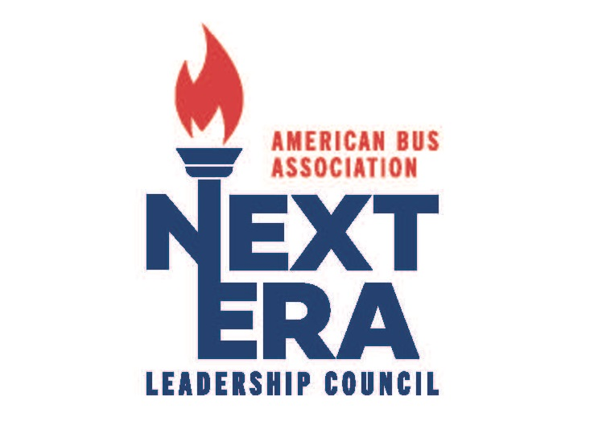
Sponsored By:

Slide 2
Original Work Group
Evan Anderson Elizabeth Hall*
Alex Berardi John Henry
Peter Borowsky Scott Henry*
Luke Busskohl* Brooks Jalbert
Mike Canine* Shannon Kaser
Ryhan Cornell Jack Kaufman
John Croswell Robert Saucedo
Kyle DeVivo Alison Sherman
Michael Giddens Michelle Tupman
Jeff Greteman*
Lauren Grote
*Current ABA Board Member

Slide 3
Driving Success Together: Empowering the Future of Motorcoach Travel
Support the next generation of Motorcoach owner-operators. Next Era Leadership Council seeks to preserve the rich and unique history of motorcoach travel while focusing on the long-term future and sustainability of the motorcoach travel and tourism industry.

Slide 4
Goal
Enhance industry future
leadership of ABA
Longevity of industry
Create and engage a pipeline of next-generation team/staff
Provide support, resources, and education to encourage and mentor future generations
Generate and drive awareness of multigenerational business operations in the motorcoach industry

Slide 5
Leadership Team
Vice Chair Kyle DeVivo
Sponsor Liaison Ryhan Cornell
Education Jack Kaufman
Marketing Ben Rome - ABA
Business Sustainability Lauren Grote Jen Stanley
Business Planning Pete Borowsky Alison Sherman
Business Operations Evan Anderson John Croswell
**Government Affairs Working with ABA Government Affairs to plan

Slide 6
Focus and Pillars
Business Sustainability
Industry safety
Customer Experience
Business Planning
Transition & Succession Planning
Crisis and Emergency Management Support
Networking and industry support
Government Advocacy
Grassroots member development
Education on working with policymakers
Business Operations
Recruitment, retention and training all employees
Human resources – Employee engagement and mental health
Technology Development

Slide 7
Council Development
Meeting Frequency
Quarterly Meetings for members
Quarterly Meetings for leadership
Future Education and Support
Survey to members providing feedback on order of importance
Marketplace – Philadelphia 2025
Friday evening - Social Reception
Roundtable/Education Session following ABA Board Meeting
Designated NELC Education Sessions

Slide 8
Council Development
ABA Marketing
NELC Prescence on ABA Communication Platforms
NELC Supporting Materials
Next Era Leadership Award
Innovation and Change
Longevity of Industry
Define Membership
Eligibility of membership
Application Process
Member Recruitment

Slide 9
Questions
ABA Staff Support – Peter Pantuso

