Slide 1
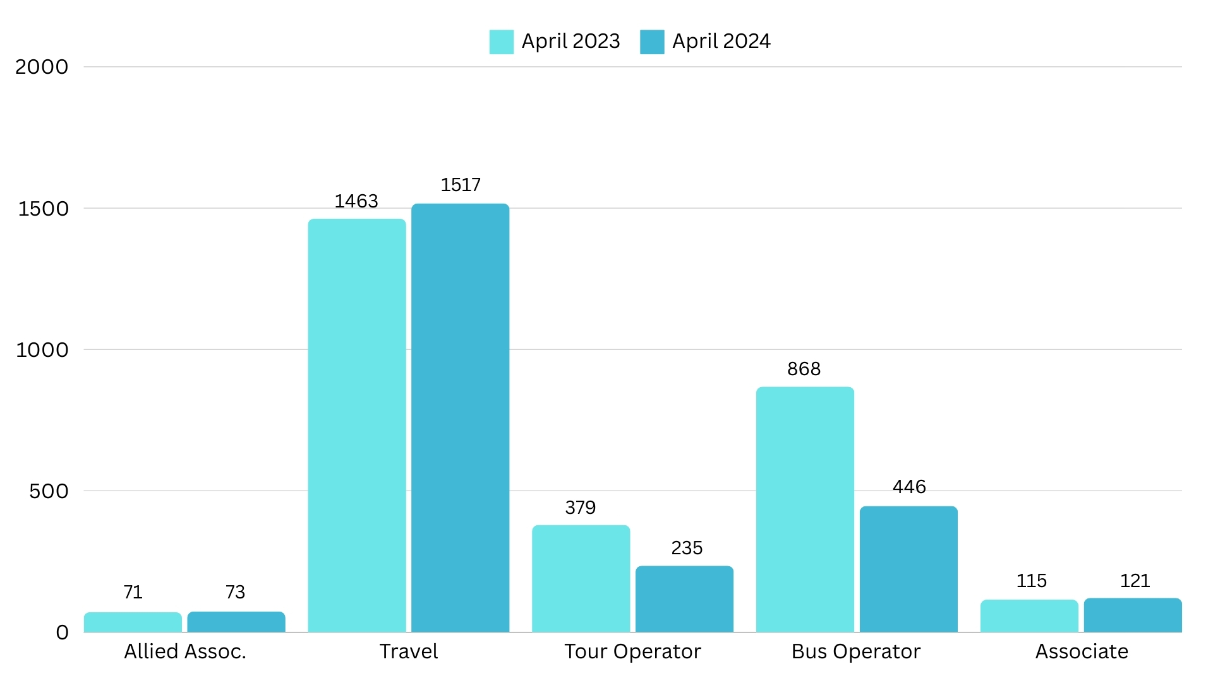
Membership Data
NOTE: Slow but positive member growth in all categories except Bus and Tour Operators. This is due to suspending a significant amount of Bus and Tour Operators for non-payment

Slide 2
Business Development/New Members
Industry Tradeshows
Reinstatement Campaign
Industry Partners and Regional
Associations
Re-Marketplace New Member Campaign
Member Referrals
Board/Council/Committee Referrals
UMA – 2/4 STS 3/20 IPW – 5/3 TMA – 6/2 Travel Alliance Partners – 6/9 PBA – 6/17 NEBA - 6/23 AMA/GMOA/SCMA - 7/21 | Midwest Bus & Motorcoach Association – 7/24 IMG – 8/6 SYTA – 8/9 NCMA/VMA/MCASC - 8/27 GNJMA – 9/17 NWMA – 10/14 CBA – 10/27 OMCA 11/4 NTA 11/17

Slide 3
Engagement
Membership Committee Making Welcome Calls
Monthly New Member Spotlight on Social Media and in Bus Bulletin
New Member Announcement on Social Media and Weekly Bulletins
New Member Orientation Webinar Every Other Month
New Member Onboarding Drip Campaign (scheduled check-ins for first year of membership)
Quarterly Member Touch Points
Groups.io - Test Online Member Chat Community
Monthly Industry/Professional Development Webinars

Slide 4
Renewal
The 2024-2025 Bus and Tour renewals have been sent. Digital and hard copies were sent
5% increase was approved and implemented for all ABA Member Categories (renewal schedule: calendar year)
After multiple and exhaustive efforts to reach them, a mass suspension was of members were suspended for non-payment

Slide 5
Other Business
New Sales CRM: TEAM does not have sales and pipeline management capabilities. Moving forward with an online sales CRM called Pipedrive, which will allow us to:
Centralize sales data and prospect communications (no more spreadsheets!)
Real time reporting on data in the prospect funnel
Sales forecasting
Goal-setting
Establishing accurate sales metrics
Ability to automate sales
Member Surveys have been sent to all members in an effort to collect accurate company and contact information. This will be an ongoing process to include major call campaign utilizing temps to make calls

Slide 6
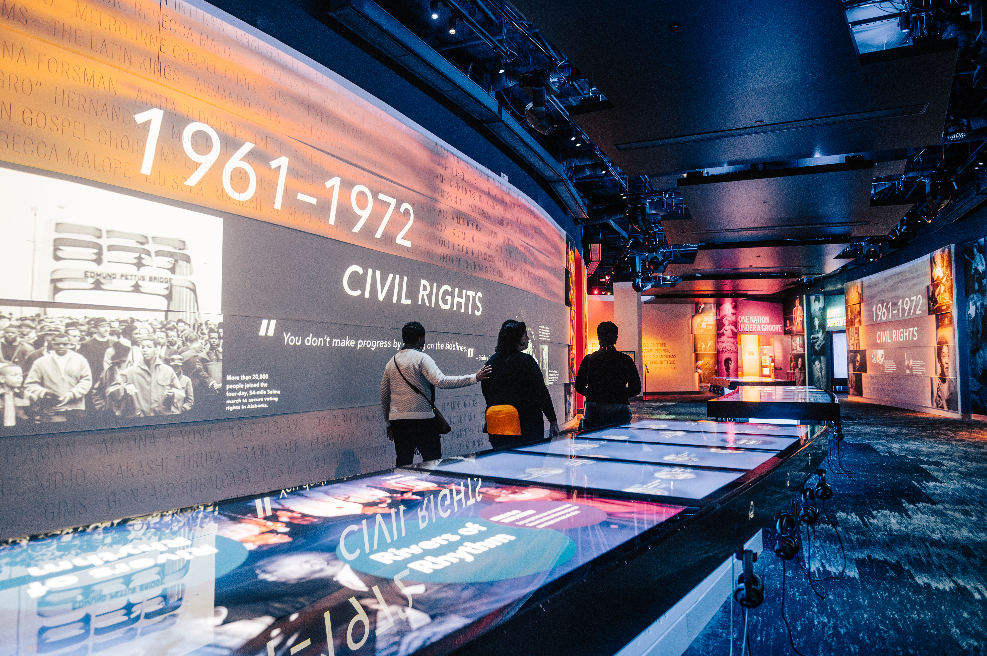
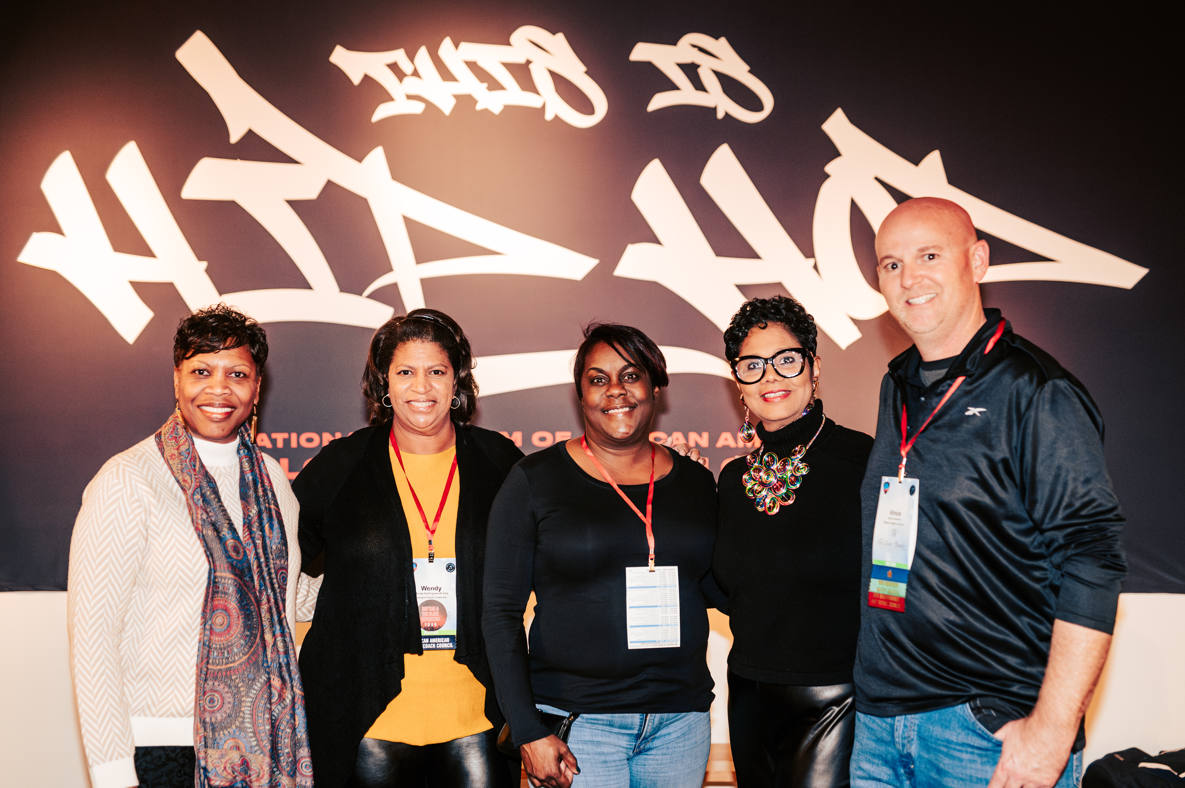
Council Activities
African American Motorocoach Council
101 Council Members
Council had their reception at the National Museum of African American Music
April Call guests:
Anjuli King, Visit Savannah
May Call guest:
Brandon Buchanan, ABA with guests Jeff Shanker and Mike McDonal

Slide 7
Committee Activities
Diversity, Equity, and Inclusion Committee
Committee had their first in person event at Marketplace in Nashville
Subcommittees have been created:
Education & Scholarship
Engagement & Outreach
Now looking ahead to 2025 Marketplace, Committee is planning an in-person event. Possibly a joint event with AAMC and HMC
Members that are certified as a Minority Owned Business, now have the ability to list it on their company profile

Slide 8
What’s Next?
Top priority: New member acquisition and retention
Other Activities
Continue with collecting member surveys and updating database. Will include major call campaign
Collect and consolidate all prospect spreadsheets and work to upload into new sales CRM
Continue targeted prospect outreach surrounding MKPL in Philly
Renew existing strategic partnerships and renegotiate partnership agreement if necessary
Considering putting together a program or event around the 100th Anniversary of ABA and Route 66

Slide 9
Thank You
Jennifer Garry
Director of Membership
American Bus Association jgarry@buses.org
202.218.7234

