Slide 1
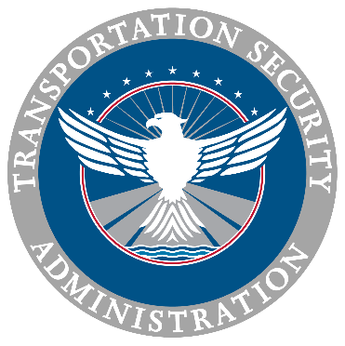
Transportation Security Administration Update
July 23, 2024

Slide 2
A Brief Introduction
Daniel A. McQuaid, Industry Engagement Manager, Highway Motor Carrier Division, Surface, PPE
Most Recent Assignment was as the TSA Attaché to Turkey, and 15 other countries from 2016 to 2024.
35 years in the Transportation Security Sector, both in industry and the federal government. New to the Surface Transportation Sector.
Recruited by FAA in October of 2001 from Northwest Airlines in the aftermath of the events of 9/11. Transitioned to TSA in March of 2003.
Contact Information: daniel.mcquaid@tsa.dhs.gov,

Slide 3
Surface Transportation Employee Vetting Notice of Proposed Rulemaking
July 23, 2024

Slide 4
What Is The Purpose Of The Proposed Rule?
The Vetting of Certain Surface Transportation Employees Notice of Proposed Rulemaking was published in the Federal Register on May 23, 2023
The NPRM proposes to implement requirements in the 9/11 Act to vet certain public transportation, freight and passenger railroad, and over-the-road bus (OTRB) employees:
Require security-sensitive employees to undergo a Level 2 Security Threat Assessment (STA)
Require security coordinators to undergo a Level 3 STA
Provide appeal and waiver procedures for vetted populations similar to those established for the Transportation Worker Identification Credential (TWIC); and
The rule also proposes to standardize the TSA vetting structure in a new Part 1530:
Vetting Standards
Fees
Redress procedures

Slide 5
What Proposed Surface Transportation Population Impacted By The NPRM?
Generally, populations covered under the Rail Security and Security Training Rules may be impacted by this rule:
Workers | Level 2 STA (Terrorism, Immigration) | Level 3 STA (Terrorism, Immigration, CHRC)
Security-Sensitive Freight Railroad Employees | 
Security-Sensitive Public Transportation and Passenger Railroad Employees | 
Security-Sensitive OTRB Employees | None
Security Coordinators of Freight Railroads |  | 
Security Coordinators of Public Transportation Agencies and Passenger Railroads |  | 
Security Coordinators of OTRBs |  | 

Slide 6
What Is The Proposed Cost Of A STA?
Proposed cost of an initial STA:
STA Level | Low | Mid | High
Level 1 (Processing, Terrorism/Other Analysis) | $50 | $63 | $76
Level 2 (Processing, Terrorism/Other Analysis, Immigration) | $52 | $66 | $80
Level 3 (Processing, Terrorism/Other Analysis, Immigration, CHRC) | $69 | $87 | $105

Slide 7
What Is The Proposed Process For Getting A STA?
TSA proposes to use its established enrollment process to vet surface employees
TSA operates a network of more than 300 enrollment centers
These enrollment centers are currently used to vet individuals participating in the following programs:
TSA PreCheck®
Transportation Worker Identification Credential (TW IC®)
HAZMAT Endorsement
Flight Training Security Program (FTSP)

Slide 8
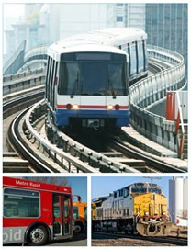
Where Can The Public Submit Administrative Questions Regarding The NPRM?
Administrative-related inquiries may be submitted by the following means:
By email at: SurfaceVetting@tsa.dhs.gov
By voicemail at: (571) 227-1039

Slide 9
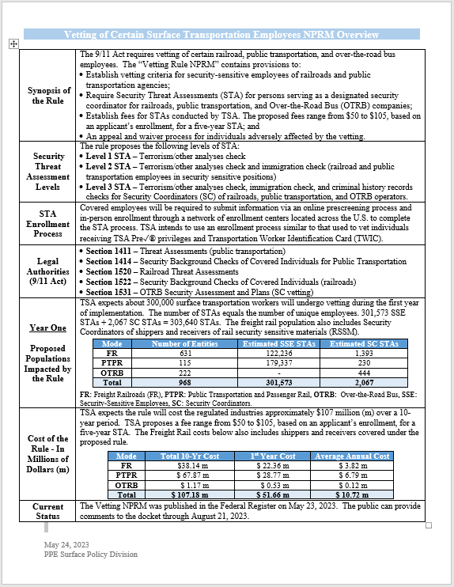
What Resources Are Available to Me?
PPE Surface Policy Team!
By email at: SurfaceVetting@tsa.dhs.gov
By voicemail at: (571) 227-1039
One page Vetting NPRM Summary
Federal Register
Vetting NPRM
Link to Regulations.gov (Submit/review comments)
Direct Link to NPRM in the Federal Register: https://www.federalregister.gov/documents/2023/05/23/2023-10131/vetting-of-certain- surface-transportation-employees

Slide 10
Vetting NPRM Current Status
The Public Comment Period closed on 21 August 2023.
The Public Comments to the NPRM are being adjudicated and TSA is preparing to publish the final rule.

Slide 11
Security Training Rule, Current Status
As of 18 July 2024, 68 OTRB Operators have reported applicability for the final rule.
TSA has approved 65 Security Training Programs, and 2 additional programs are under review.

Slide 12
Some Thoughts on Cyber
NWA.
CloudStrike Global Outage on 19 July.

Slide 13
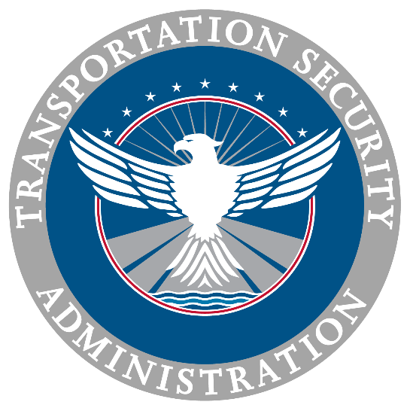
Please feel free to ask us any questions.
Q & A

Slide 14
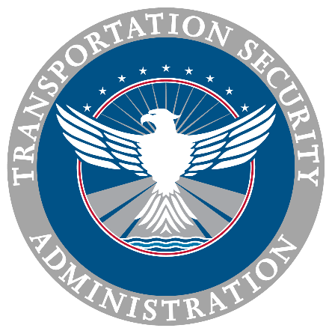

Slide 15
TSA Surface Security Outreach Programs and Resources

Slide 16
Surface Security Outreach Programs
Baseline Assessment for Security Enhancement (BASE)
Risk Mitigation Activities for Surface Transportation (RMAST)
Exercise Information System (EXIS)
Security Enhancement Through Assessment (SETA)
T-Start (Transportation Security-Plan Template and Assessment Review Toolkit)
Notes:
These are some of the TSA security-based programs that we offer at no-direct cost to stakeholders. The only cost is time.

Slide 17
Surface Security Outreach Programs
Baseline Assessment for Security Enhancement (BASE)
Strategic Level
Exercise Information System (EXIS)
Risk Mitigation Activities for Surface Transportation (RMAST)
Operational Level
Security Enhancement Through Assessment (SETA)
Tactical Level
TSI-facilitated, stakeholder-specific security tabletop exercise
Collaborative front line employee assessment
Assessment of security policies and procedures
TSA-provided security training
T- Start

Slide 18
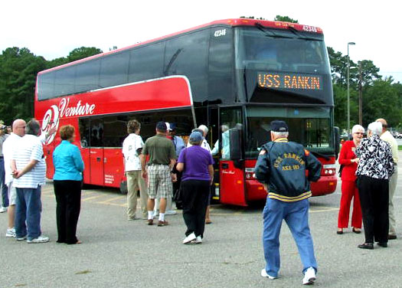
BASE
Baseline Assessment for Security Enhancement
Voluntary, no cost program
Comprehensive security assessment
4 General Areas:
Management and Accountability
Personnel Security
Facility Security
Vehicle Security
General Areas divided into 20 Security Action Item (SAI) categories
SAI categories divided into 100 specific security line elements/questions
Questions developed from industry standards and security best practices with input provided from industry stakeholders
Foundation for all TSA Surface Security Outreach Programs
Notes:
Any/all information shared with TSA as part of this assessment process is secured as Sensitive Security Information and protected under 49 CFR Part 1520.

Slide 19
BASE
Baseline Assessment for Security Enhancement
What types of documents do we review?
Security Plan / Procedures
Written Risk Assessment Report
Emergency Response Plan / Procedures
Safety Plan / Procedures
Continuity of Operations Plan (COOP) Plan
Business Recovery Plan
Company / Facility Contact or Phone Tree List(s)
Written IT Security Guidelines
Emergency Services Contact or Phone Tree List(s)
Training Manual
Drivers’ Manual
Security Training Records-key administrative/management staff and several bus operators
Notes:
Any/all information shared with TSA as part of this assessment process is secured as Sensitive Security Information and protected under 49 CFR Part 1520.

Slide 20
BASE
Baseline Assessment for Security Enhancement
What types of documents do we review-Cont’d?
Security Sensitive Information (SSI) Policy/Equivalent Florida Policy
Any other documents pertaining to security
Access control requirements (building, bus parking areas, etc.)
Employee Identification Policy (i.e. Employee ID wearing requirements)
Location of all bus and Transportation Department vehicle parking areas
Background and driver’s license checks for driver and non-driver Transportation Department personnel
Any documents that may assist with the security assessment
Note-All documents/information received will be protected pursuant to 49 Code of Federal Regulations (CFR) Part 1520 and will not be released to anyone other than the originating stakeholder.
Notes:
Any/all information shared with TSA as part of this assessment process is secured as Sensitive Security Information and protected under 49 CFR Part 1520.

Slide 21
BASE
Baseline Assessment for Security Enhancement
Supports DHS goals to:
ESTABLISH a baseline of the surface transportation stakeholder’s internal security processes, procedures and policies against industry standards and security best practices.
IDENTIFY security program strengths and weaknesses.
ELEVATE the surface transportation stakeholder’s overall security environment through development of corrective action recommendations to mitigate any security program weaknesses detected during the review.
ENHANCE security partnership between TSA and surface transportation stakeholders through ongoing engagement.
Results provided through an Executive Summary Report
Provides non-legally binding corrective action recommendations that may increase the surface transportation stakeholder’s overall security posture

Slide 22
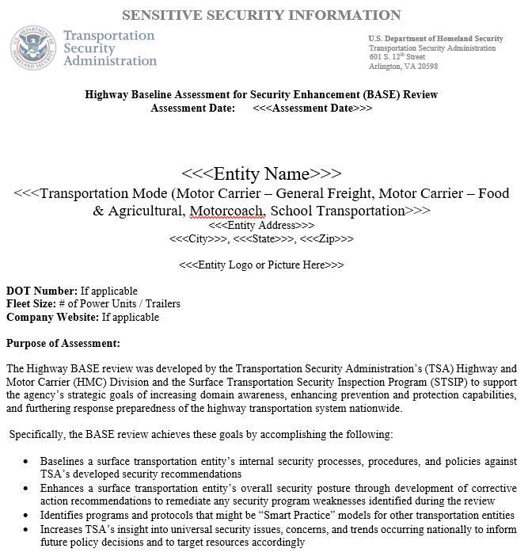
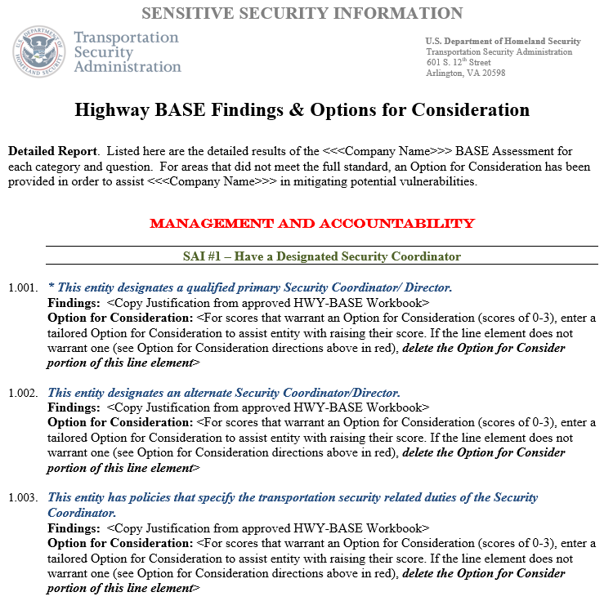
BASE
Baseline Assessment for Security Enhancement
What you receive-Comprehensive Executive Summary
Notes:
Any/all information shared with TSA as part of this assessment process is secured as Sensitive Security Information and protected under 49 CFR Part 1520.

Slide 23
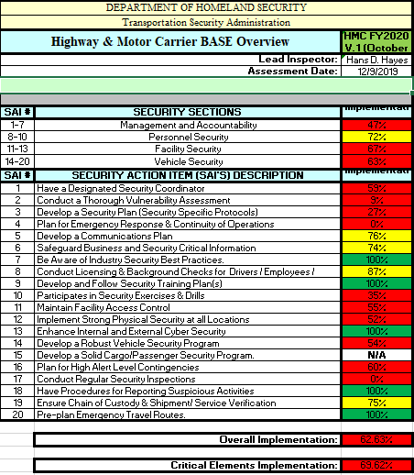
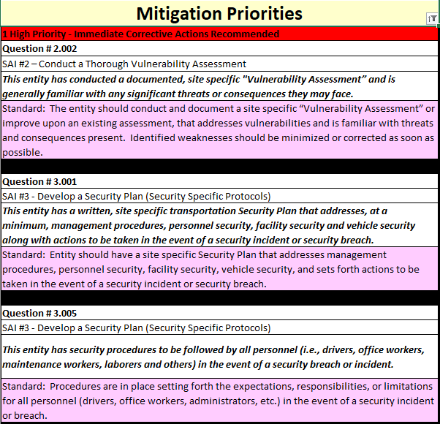
BASE
Baseline Assessment for Security Enhancement
What you receive
Comprehensive “Scoring” Chart
SAI Mitigation Priority Chart
Notes:
Any/all information shared with TSA as part of this assessment process is secured as Sensitive Security Information and protected under 49 CFR Part 1520.

Slide 24
BASE
Baseline Assessment for Security Enhancement
What have we seen?
Access control at bus depots/parking locations and transportation facilities
A lack of vulnerability assessments for transportation facilities.
A written, site-specific transportation security plan
A lack of security procedures for all personnel broken down by position
Drivers
Office workers/Administrative personnel
Maintenance workers
Plans for Emergency Response and Continuity of operations
Suspicious activity reporting-internally
Security-related Exercises and
Identification of a dedicated security coordinator and alternate
Lack of bus-based GPS and functional panic buttons on bus radios
Notes:
Any/all information shared with TSA as part of this assessment process is secured as Sensitive Security Information and protected under 49 CFR Part 1520.

Slide 25
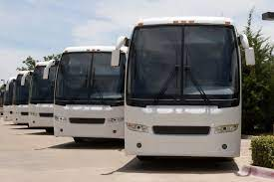
RMAST
Risk Mitigation Activities for Surface Transportation
Voluntary, no cost, series of security programs
Assists surface transportation stakeholders in mitigating risks identified through participation in other TSA programs, such as BASE
Provides tools to respond to current threats and vulnerabilities
Notes:
Site security observations-especially during high volume/high traffic times, stakeholder engagement activities-high visibility engagement with stakeholder officials to add a “presence” to various venues.

Slide 26
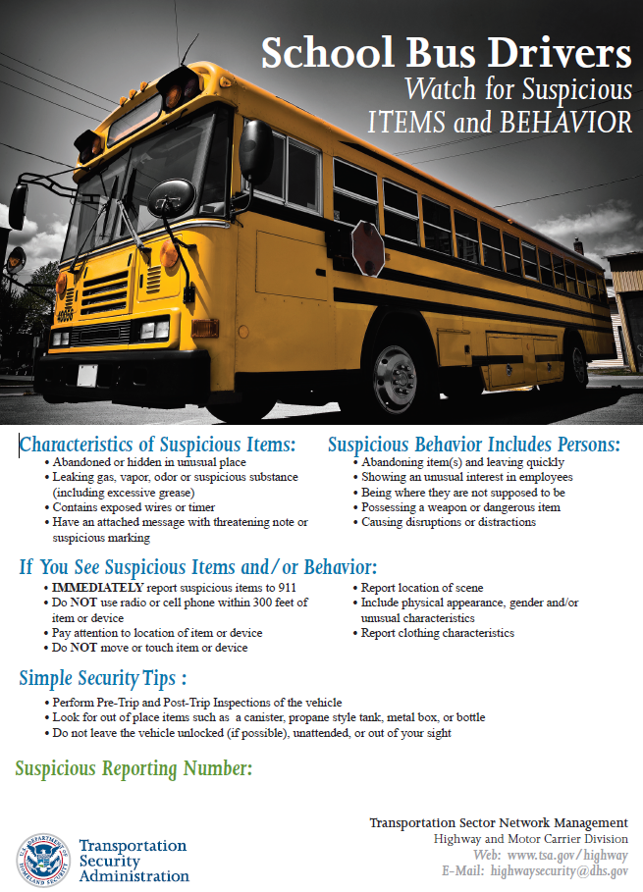
RMAST
Risk Mitigation Activities for Surface Transportation
Stakeholder Engagement:
Formal Training
General Security Awareness
Explosive Hazard Recognition and Safety Awareness
Familiarization Briefings
TSA Highway and Motor Carrier Modal Intelligence Briefing
Vehicle Security Inspections
Recognizing and Responding to Unattended and Suspicious Items
Identifying and Responding to Suspicious Behavior
Security Resources
Counterterrorism Guide(s)

Slide 27
RMAST
Risk Mitigation Activities for Surface Transportation
Additional Familiarization Presentations:
Active Shooter/Active Assailant
Behavior Awareness and Detection for Operators
TSA Intelligence Briefings (SSI and non-SSI)
Improvised Explosive Device Awareness and Detection
First Observer Plus
Sensitive Security Information (SSI Training)
Cyber-security Workshop (5N5)
Notes:
We often assist with in-service presentations and work with Directors of Transportation and (known) School Safety Specialists.

Slide 28
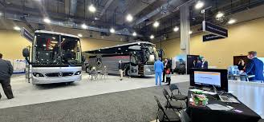
EXIS
Exercise Information System
Voluntary, no cost program
Prepares a surface transportation stakeholder to effectively respond to security incidents
Discussion-based exercises
Single or Multi-agency
Security measures:
Prevention
Protection
Mitigation
Response
Recovery

Slide 29
EXIS
Exercise Information System
EXIS Workshop
Small group
Single scenario
EXIS Tabletop
Large group (15 – 20 participants)
Multi-scenario
Notes:
EXIS Tabletops are scheduled through our HQ Team who are HSEEP-certified exercise practitioners. There are between 8-12 scheduled per year and are multi-agency exercises designed to examine a stakeholders response to a series of linked or un-linked events.

Slide 30
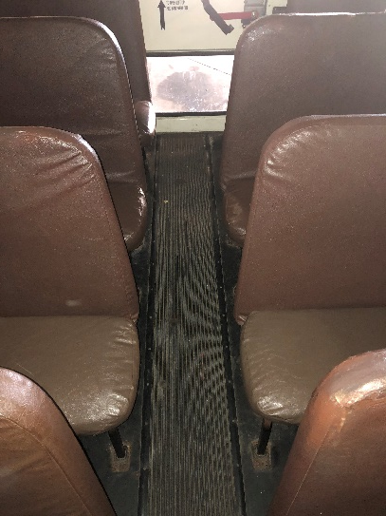
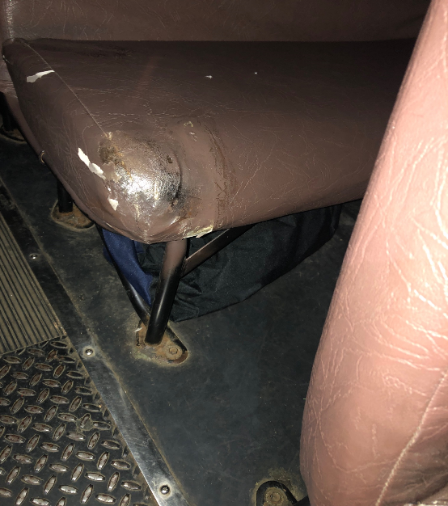
SETA
Security Enhancement Through Assessment
Voluntary, no cost program
Collaboration between TSA and a surface transportation stakeholder
Evaluates and improves vehicle inspection and security procedures
Pre-Trip Inspection
In-Service Inspection
Post-Trip Inspection
Suspicious Individual/Person

Slide 31
SETA
Security Enhancement Through Assessment
Tactical level assessment
Covert placement of unattended bags on multiple vehicles simultaneously or introduction of “suspicious” person in secure area
Phase I: Identify and Assess
Identify vulnerability
Initial assessment to establish a security baseline
Phase II: Mitigate
TSA-provided security briefings/training to frontline employees
Phase III: Reassess and Sustain
Follow-up assessment measuring program changes in security posture
Sustainment plan to maintain an increased level of security

Slide 32
T – START
Transportation Security-Plan Template and Assessment Review Toolkit
Workshop
Group / Up to 20 Security Partners
Personalized
Optional one-on-one to address individual Security
Tailored Security Plan
Expected Outcome: Mitigate, Bolster, and Collaborate
Notes:
EXIS Tabletops are scheduled through our HQ Team who are HSEEP-certified exercise practitioners. There are between 8-12 scheduled per year and are multi-agency exercises designed to examine a stakeholders response to a series of linked or un-linked events.

Slide 33
Surface Security Outreach Programs
Baseline Assessment for Security Enhancement (BASE)
Risk Mitigation Activities for Surface Transportation (RMAST)
Exercise Information System (EXIS)
Security Enhancement Through Assessment (SETA)
T-Start (Transportation Security-Plan Template and Assessment Review Toolkit)
Notes:
These are some of the TSA security-based programs that we offer at no-direct cost to stakeholders. The only cost is time.

Slide 34
TSA Surface Security Outreach Programs and Resources
Visit our Table for additional information and Handouts

